Slide 1



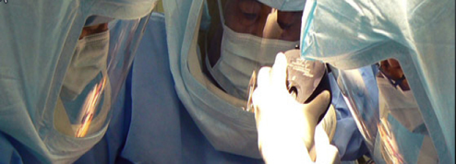

The Future Of Dual Mobility In Younger Patients
EFORT PRAGUE 2015
Jean Alain Epinette - France
Société Française de Chirurgie Hanche et genou

Slide 2
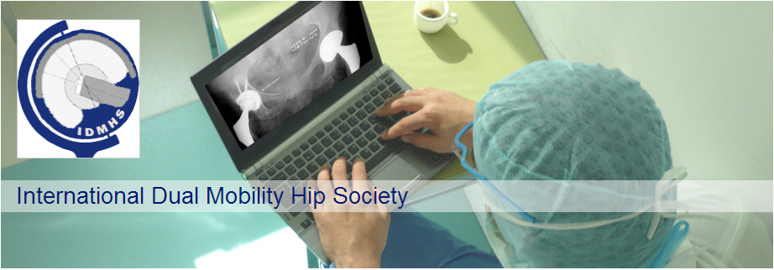
The Future Of Dual Mobility In Younger Patients
SFHG
Société Française de Chirurgie Hanche et genou
IDMHS
France
USA
Jean Alain Epinette
Loÿs Descamps
Jean Marc Puch
Jean-Louis Prudhon
André Ferreira
Guy Dehri
Rémi Philippot
Richard Béracassat
Philippe Tracol
Steven Harwin
Geoffrey Westrich
Kipling Sharpe

Slide 3


New Challenges at 21st Century
Prevent from complications
Provide long term great outcome
2015

Slide 4




1
Hip Instability has become nowadays one of the most frequent cause of failures after THAs…
The Epidemiology of Revision Total Hip Arthroplasty in the United States
Bozic, K.., JBJS Am 2009
" … The most common causes of revision were instability/dislocation (22.5%), mechanical loosening (19.7%), and infection (14.8%)."
2009 report :
2nd cause/ 3yrs
1/5 of revisions
2011 report :
2nd cause
¼ of revisions
2012 report :
2nd cause

Slide 5
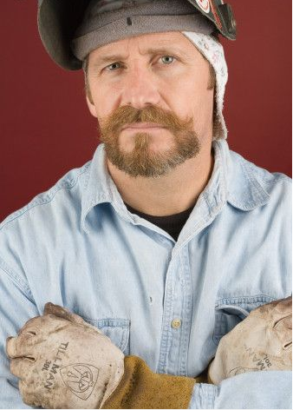
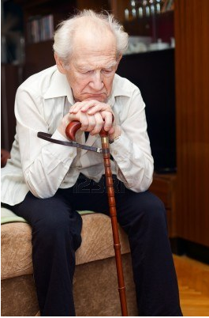

Hip Instability : Who gets concerned ?
?

Slide 6


Hip Instability = a personal previous study (EHS / Milano -2012)
Who gets concerned (Fixed Bearings)?
A prospective 24 years study (1987-2011) on our OrthoWave DataBase
Primary Hip replacement with Fixed Bearings
Prevalence of Dislocation and Revision due to dislocations in 2 Groups
  Over 70 yrs: 1634 hips (mean age 76.6 yrs) = OPG
  Under 60 yrs: 1030 hips (mean age 50.3 yrs) = YPG

Slide 7
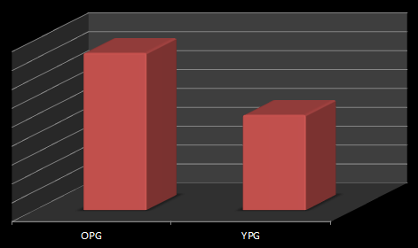


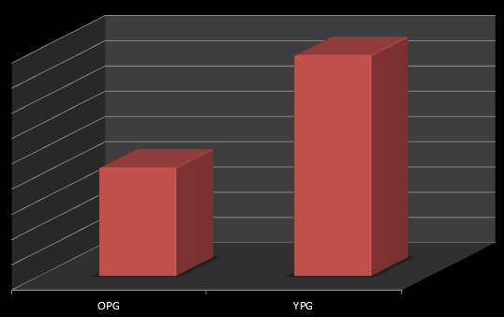

Dislocation Rates
4.16%
2,52%
Significantly more dislocations in the elder patients >70 yrs
Revision Rates
1.75%
However the revisions for recurrent dislocations were significantly more frequent < 60 yrs
0.86%

Slide 8
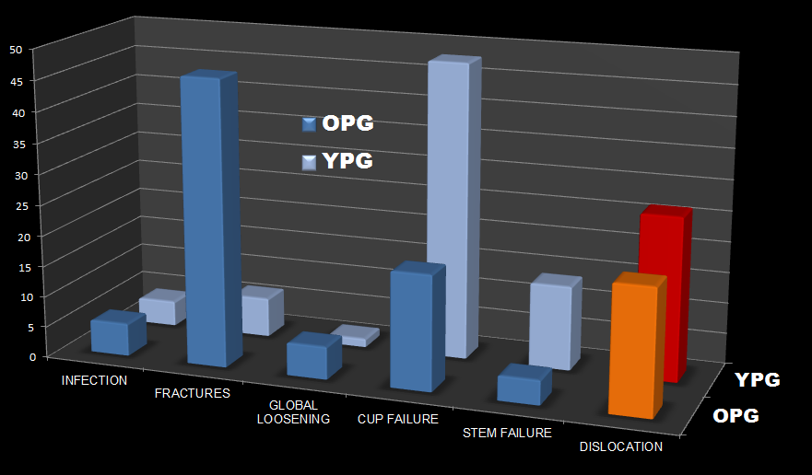
Dislocation
= second cause of revision in each group
26.5%
20.3%

Slide 9
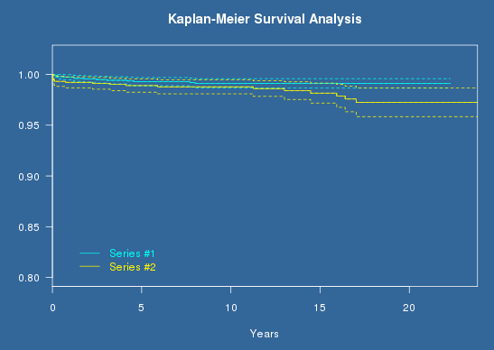



Hip Instability in Young Patients IS a concern with Fixed Bearings !
Kaplan-Meier Analysis:
Revision for Recurrent dislocations as end-point
@ 22 yrs: 99,1% (0.986- 0.996)
@ 23 yrs: 97.2% (0.958- 0.987)
Log-rank = 4.36
P-value: 0.0367 (+) p < 0,05

Slide 10
Hip Instability in Young Patients IS a concern with Fixed Bearings !
Dislocations and Revision due to recurrent dislocations:
  More dislocations in the elderly
  However…
  Higher revision burden in young patients (2.8% vs. 0.9%, p<0.05)
  Revision for dislocations are the second cause for revision <60 yrs

Slide 11
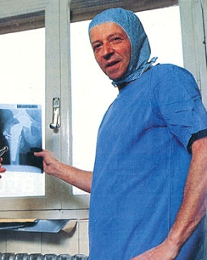
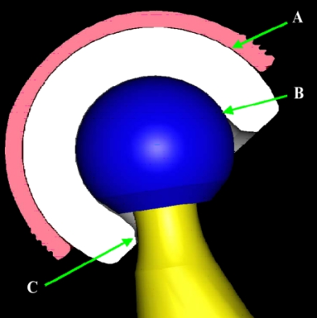
2
Dual Mobility Cups ARE one of the most efficient options to prevent from Instability
DM Cups: The solution
Gilles Bousquet
France -1974
Stroh A et al. 2012
Dual-mobility prostheses (tripolar) = greater stability with an increased range-of-motion, along with potentially reduced wear.
Mean overall dislocation rate = 0.1% for primary total hip arthroplasty and 3.5% for revisions, compared with 2-7% for standard primary total hip arthroplasties and up to 16% for revisions. "

Slide 12

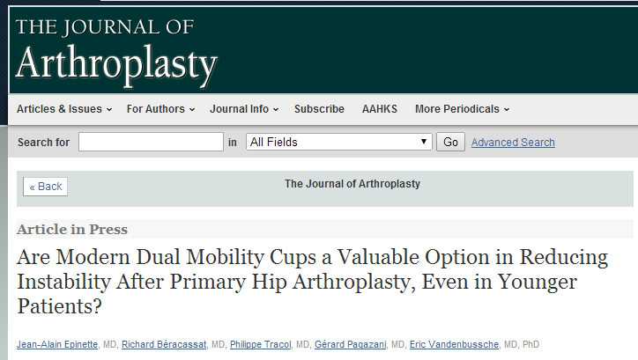
J Arthroplasty. 2014 Jun;29(6):1323-8.
Are modern dual mobility cups a valuable option in reducing instability after primary hip arthroplasty, even in younger patients?
Epinette JA¹, Béracassat R², Tracol P³, Pagazani G⁴, Vandenbussche E⁵.
<… No dislocation, migration, tilting, wear, or intra-prosthetic dislocation was recorded within each of the two cohorts. Survivorship for cup failures at this 4-year period was ideal at 100% in the younger patients, and 99.7% in the older group of patients.>

Slide 13
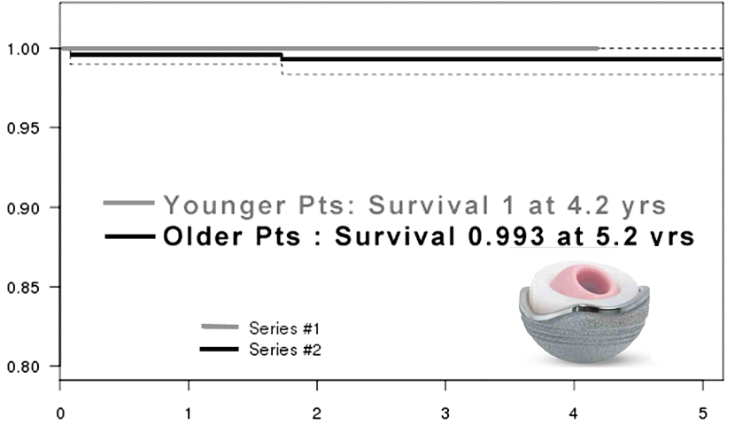
J Arthroplasty. 2014 Jun;29(6):1323-8.
Are modern dual mobility cups a valuable option in reducing instability after primary hip arthroplasty, even in younger patients?
Epinette JA¹, Béracassat R², Tracol P³, Pagazani G⁴, Vandenbussche E⁵.
J Arthroplasty. 2014 Jun;29(6):1323-8.

Slide 14

3
So far, unfortunately DM cups are often regarded as a "salvage procedure"…
Official recommendations from French Health Authorities
WHY ???
Very Old Patients
Neurologic/ Muscular diseases
High risk of Instability

Slide 15

Issues with "classic" DM Cups
438 dual mobility socket @ 17-yr follow-up
R. Philippot – OTSR 2008
Intra-prosthetic dislocation
Loosening
Wear
2,97%
5,25%
1,60%
"According to numerous reports the dual-mobility cup appears to offer a safe, effective and durable solution to hip instability.
However, significant complications have been highlighted after the use of first generation cups, which were mainly due to
premature wear of the polyethylene, leading to early intraprosthetic dislocations
or insufficient means of fixation.

Slide 16
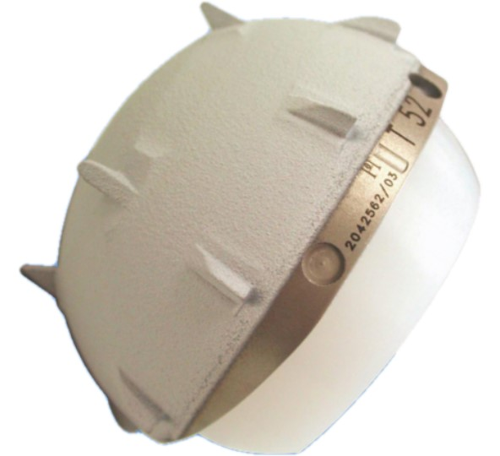
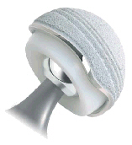
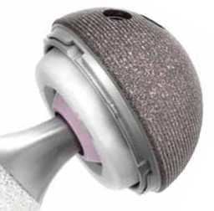
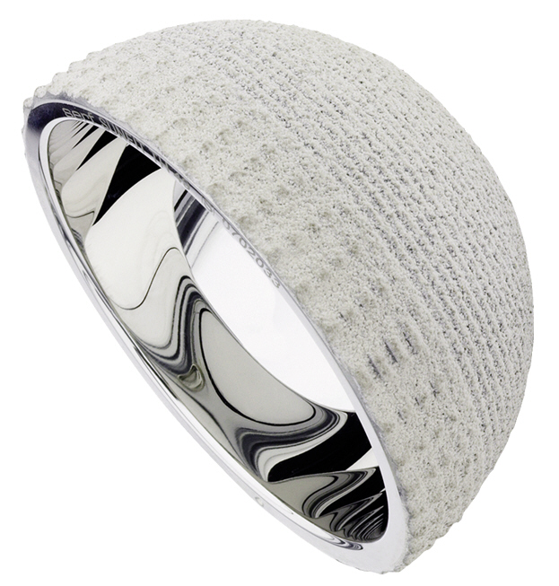
New Deal with "modern" DM Cups
✗
"classic"
✓
Loosening
No Performing Interface
No appropriate substrate
Excellent Bony Ongrowth
HA on SecureFit / Tritanium
Excellent Substrate : Titanium

Slide 17
New Deal with "modern" DM Cups
✗
"classic"
✓
Intraprosthetic dislocation
1/3 "pure wear" retention device
1/3 loosening 3rd wear (UHMPE)
1/3 impingement fibrosis/bone
Better Design
Better locking mechanism
Secure Liner retention

Slide 18
New Deal with "modern" DM Cups
✗
"classic"
✓
Wear
Regular UHMPE as in Fixed Bearings cups
New Bearings might meet the challenge !

Slide 19
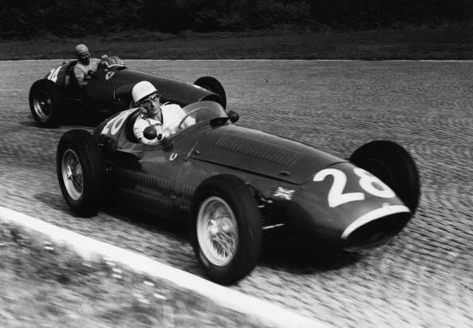
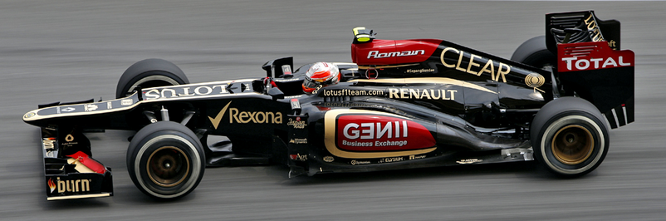
4
The current limitations can be seen as obsolete with modern devices !!!
!

Slide 20
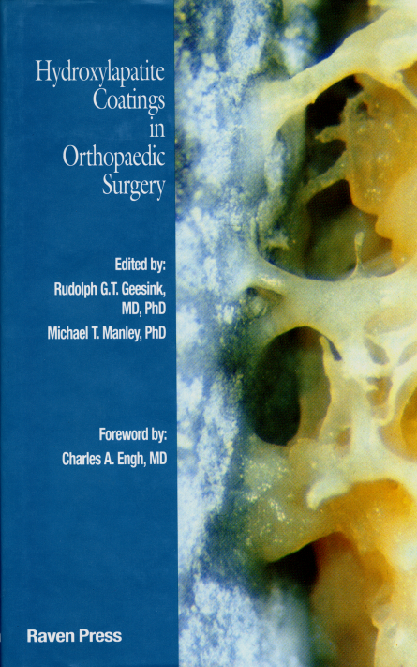
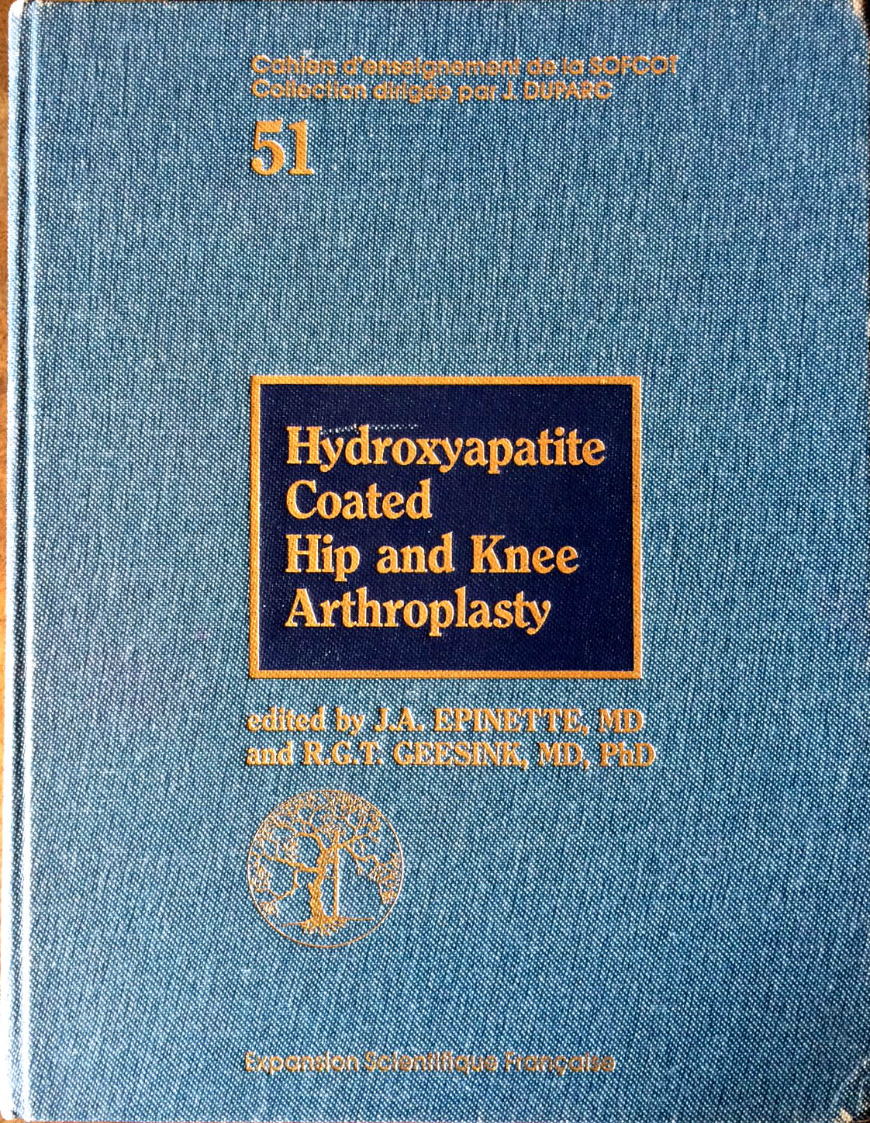
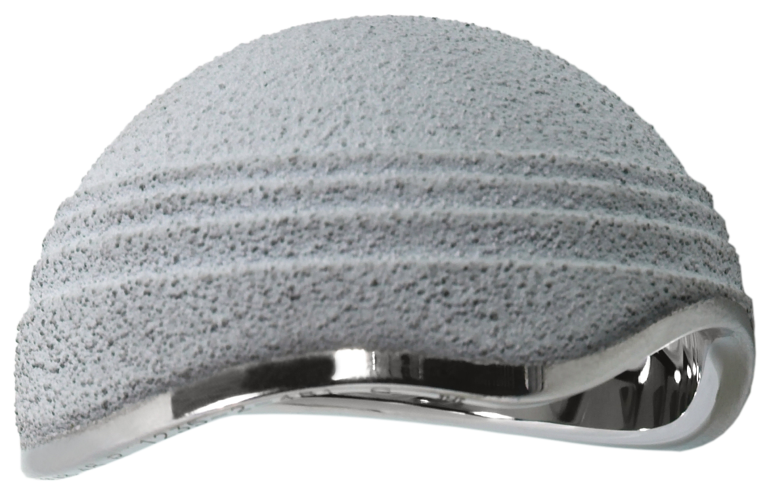
➔ Fixation of these new DM cups compare favorably with the best fixed bearing cups !

Slide 21
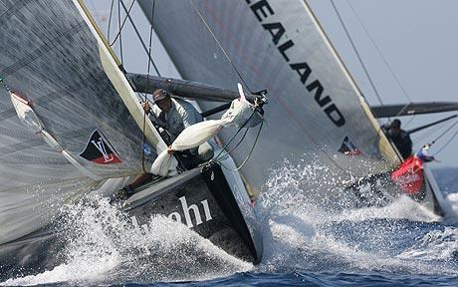
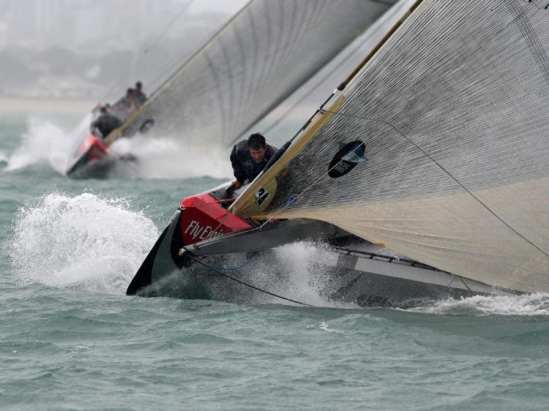
➔ New PE bearings in DM might stand the time !
CoC
MoM
DM + HXLPE : The Challenger ?...

Slide 22
J Arthroplasty. 2014 Jul;29(7):1369-72.
No differences found in bearing related hip survivorship at 10-12 years follow-up between patients with ceramic on highly cross-linked polyethylene bearings compared to patients with ceramic on ceramic bearings.
Epinette JA¹, Manley MT²
< … In addition, there were no significant differences in clinical and radiographic findings between cohorts. We concluded that alumina on HXLPE bearings are a reasonable lower cost alternative to ceramic on ceramic bearing couples>

Slide 23
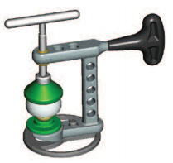
Mechanical Strength
A few words about ANNEALED vs. REMELTED HXLPE !!!
-35 %
✗
✗
OK
Annealed
Remelted
Remelted
Regular PE
Regular PE
Remelting after irradiation significantly changes the cristallinity of PE
The more irradiated, the weaker is the mechanical strength of PE

Slide 24
A few words about ANNEALED vs. REMELTED HXLPE !!!
Fatigue tests
Survival tests after liner destructions
No adverse effect upon liner elasticity and further retention capabilities after fitting the head in ANNEALED HXLPE…
= prevents from any further IPD
OK
Annealed
Remelted
Remelted

Slide 25
New Challenges at 21st Century
Prevent from complications
Provide long term great outcome ???
2015

Slide 26
What about the fate of DM cups in Young Patients ???
A multicenter prospective study by:
IDMHS
Jean Alain Epinette
Loÿs Descamps
Jean Marc Puch
Jean-Louis Prudhon
André Ferreira
Guy Dehri
Rémi Philippot
Richard Béracassat
Philippe Tracol
Steven Harwin
Geoffrey Westrich
Kipling Sharpe
USA
France

Slide 27
A brief note about IDMHS
An International Scientific Society devoted to DM knowledge
Not sponsored, led by Surgeons for Surgeons
Open to any member of the Orthopaedic Community, getting involved in DM options
to share skills and experience in Dual Mobility cups (addressing any "modern" brand)
Official launch in 2016 in its first Lausanne Congress (Switzerland – Olivier Guyen)
Join us at idmhsinfo@gmail.com

Slide 28
A IDMHS ongoing observational study on DM cups <55 yo
  ➔ Population at maximal risk!
747 hips in 661 patients
A preliminary report of "Modern" Dual Mobility in <55 years old Patients
Multicenter International 15 years study (2000-2015)
Data gathered and analyzed on the on line OrthoWave DataBase
Primary Hip replacement
Prevalence of Dislocations/ and Revisions due to Instability
Systematic record of DM related potential complications

Slide 29
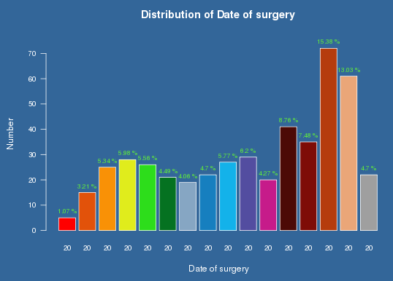
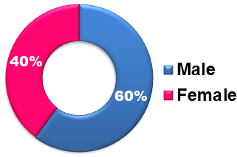
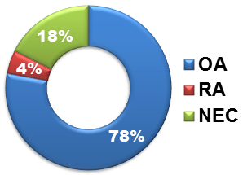
Patients
747 primary Hips in 661 Patients
Mean Age : 49,2 yrs (18-55)
2000 01 02 03 04 05 06 07 08 09 10 11 12 13 14 15

Slide 30
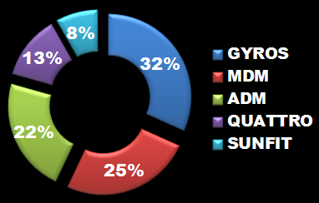
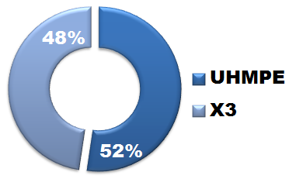
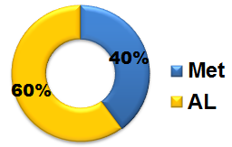
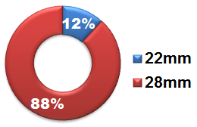
Implants
747 "Modern" DM Cups
Anatomical design (preventing from Psoas conflict)
Improved biological fixation (HA on Ti / Tritanium)
New generation of PE liners (improved PE or HXLPE)
ADM
CUP
QUATTRO
PE
MDM
HEAD
SUNFIT

Slide 31
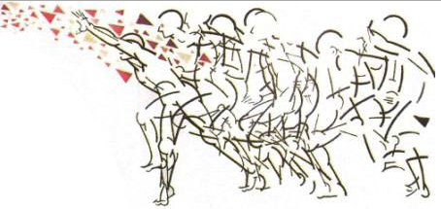
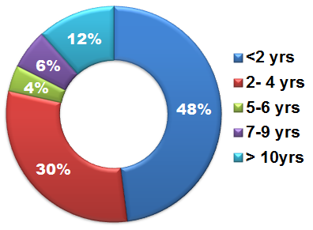
Follow-Up
Average Follow-Up: 41.8 mos
(Max: 169 mos)
HHS | PreOp | 2 years | Latest
Mean | 47.68 | 93,68 | 93,36
Min | 2 | 58 | 53
Max | 89 | 100 | 100
Clinical Scores
/ 100 points

Slide 32
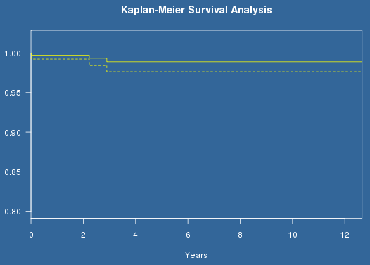
12-year Survival with "modern" DM cups <55 yo
End Point: Any cup (or global) revision for any cause
Period (yrs) | N° event | Survival | Std.err | -0.05 | +0.05
0 - 0.02 | 0 | 1 | 0 | 1 | 1
0.02 - 2.23 | 1 | 0.997 | 0.003 | 0.992 | 1
2.23 - 2.9 | 1 | 0.993 | 0.005 | 0.984 | 1
2.9 - 12.66 | 1 | 0.989 | 0.006 | 0.976 | 1
Male, OA, 50yo
Early migration at D10t (technical pb)
Cup revision for any cause:
98.9% at 12.7 yrs
Male, NEC post TR, 41yo
Painful Hip (neurotrophic)
Male, OA, 50yo
Anterior conflict at Y3

Slide 33
12-year Survival with "modern" DM cups <55 yo
Dual Mobility-related Complications or Adverse Events
Dislocation
N = 0
IPD
N = 0
Instability
N = 0
Wear/Lysis
N = 0
Loosening
N = 0
Anterior Conflict
N = 1 (0,13%)
Gyros Cup

Slide 34
The Future Of Dual Mobility In Younger Patients
1
SFHG
A 12-year ongoing international multicenter study upon the fate of "modern" dual mobility cups with 747 Cups from 12 surgeons (France-USA)
So far, excellent outcome with a 12,7yrs survival at 98,9%
No DM-related complication recorded: 0 dislocation/instability, 0 wear/lysis, 0 loosening… only 1 anterior conflict (0,13%)
On the whole, 3 failures <3 yrs, none later on until 12-year
Société Française de Chirurgie Hanche et genou
IDMHS

Slide 35
The Future Of Dual Mobility In Younger Patients
2
SFHG
Interest +++ of a huge international multicenter observational registry upon these "modern" DM cups
Will help to a better knowledge of the ultimate fate of DM options and maybe set up a new "Gold Standard" in acetabular replacement
Would allow to state on the interest of anatomical shape of the shell, and gain obtained by HXLPE vs.UHMPE ?
Anyway, and so far, indications would be worth getting expanded !
Société Française de Chirurgie Hanche et genou
IDMHS
Thanks for your kind attention !☺…

