Slide 1
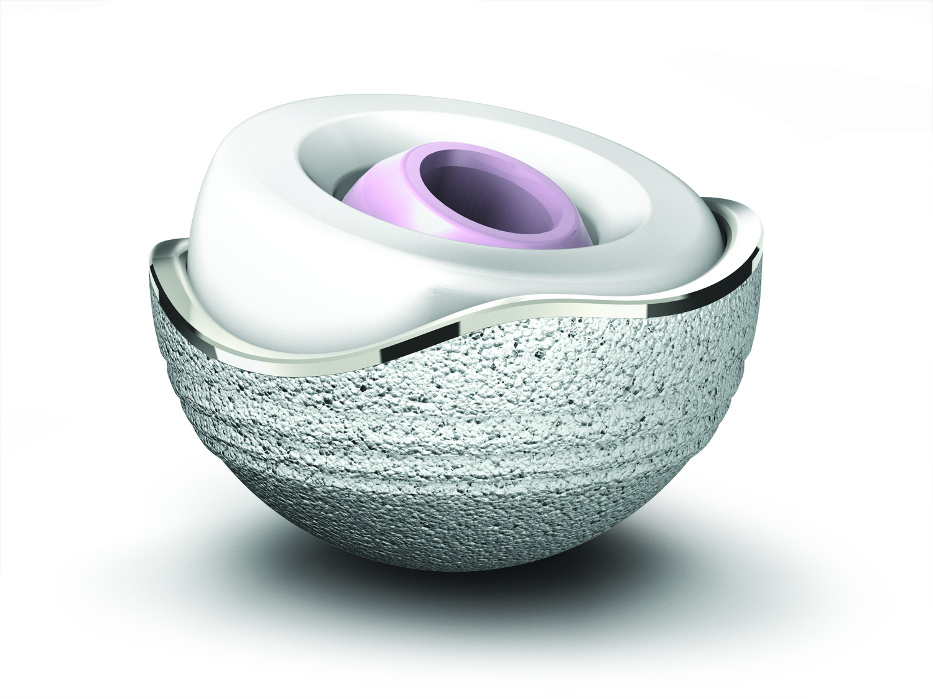
Intérêt du Cotyle ADM en arthroplastie de première intention chez le sujet jeune
Docteur Richard Béracassat Alès
Docteur Jean Alain Epinette Bruay Labuissière

Slide 2
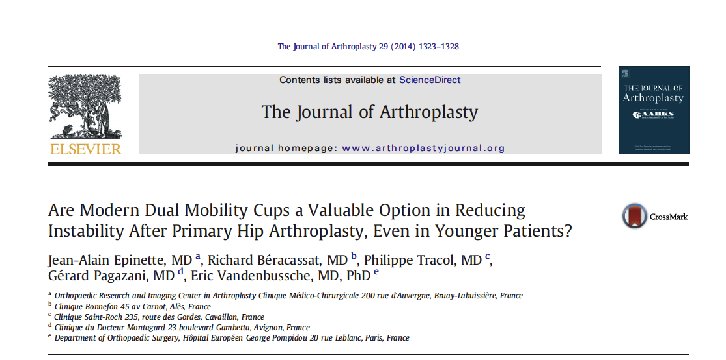

Slide 3



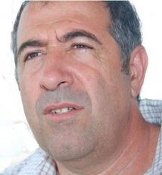

Jean-Alain Epinette**
MD
Bruay-Labuissière - France
President of the French Hip & Knee Surgery Society
The Authors
Eric Vandenbussche * MD. PhD
Paris – France
ADM French Group
Richard Béracassat *
MD.
Ales – France
ADM French Group
Gérard Pagazani * MD.
Avignon - France
ADM French Group
Philippe Tracol * MD.
Cavaillon – France
ADM French Group
DOI: * Royalties from Stryker®, **Speaker, presentations for Stryker®

Slide 4
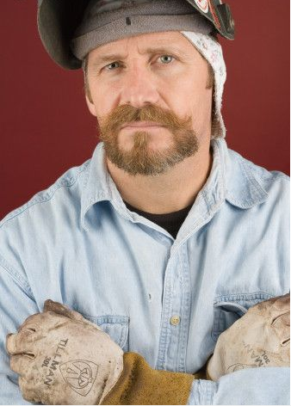
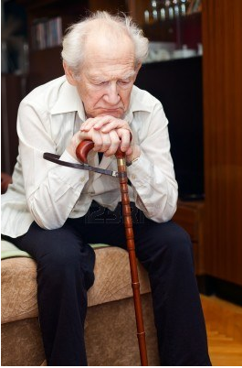
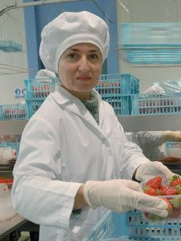
New Challenges at 21st Century
Prevent from complications
Provide a very long term great outcome
Rapid recovery

Slide 5
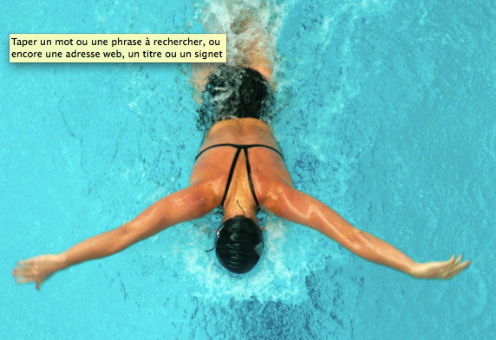


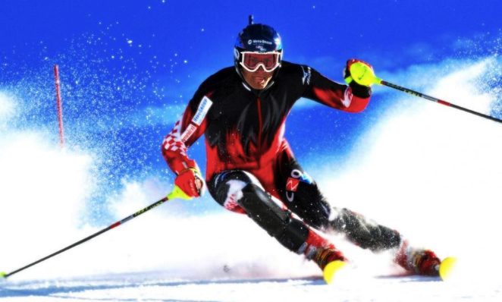
Exigences différentes

Slide 6
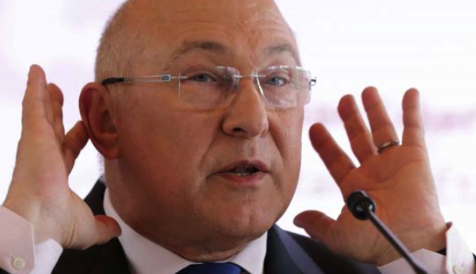
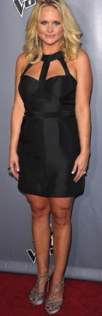
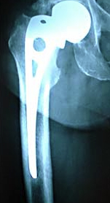
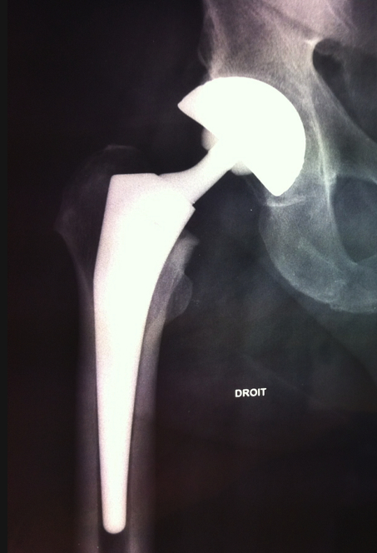
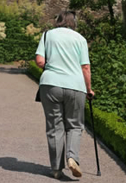
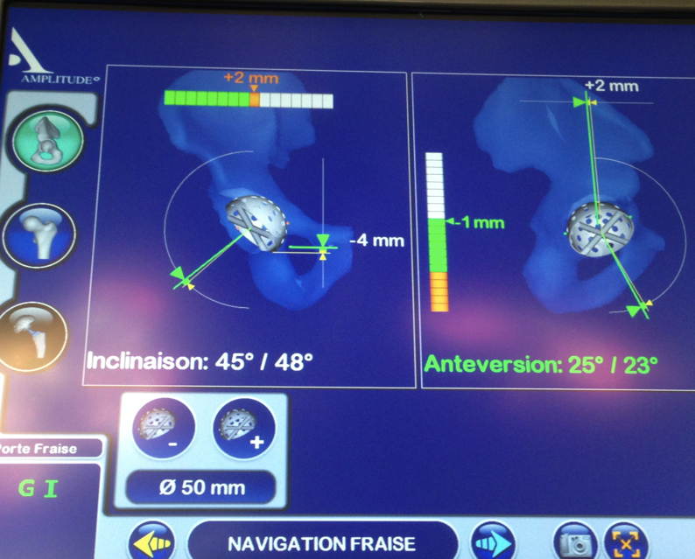
Exigences différentes
€€€

Slide 7
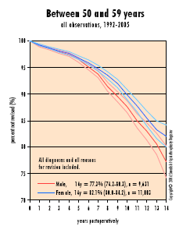
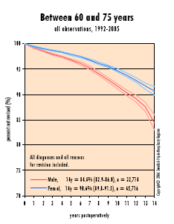
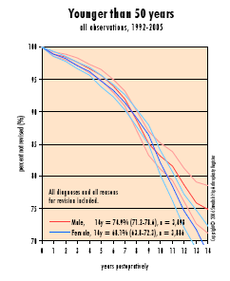
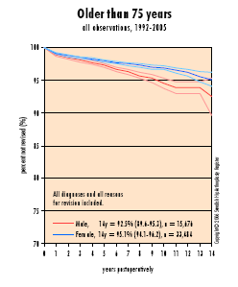
Failures / age
Notes:
Before we get to that, let’s remind ourselves of why this is important
The Swedish Hip register tells us interesting things
Aseptic loosening I still a problem
Dislocation is actually increasing
Younger patients have more failures for aseptic loosening
But its not only the young patients who want to be active

Slide 8
Targets
Avoid the early complications (dislocations)
Reproduce an optimal articular function (anatomy)
Reduce the wear (Tribology)
Optimize the quality of Implantation
Reduce the operating trauma, (MIS, computer-aided surgery)
Notes:
Depuis + de 6ans 2 groupes de Chir ortho et un industriel Leader mondial se sont penché sur le problème avec 4 axes de travail

Slide 9
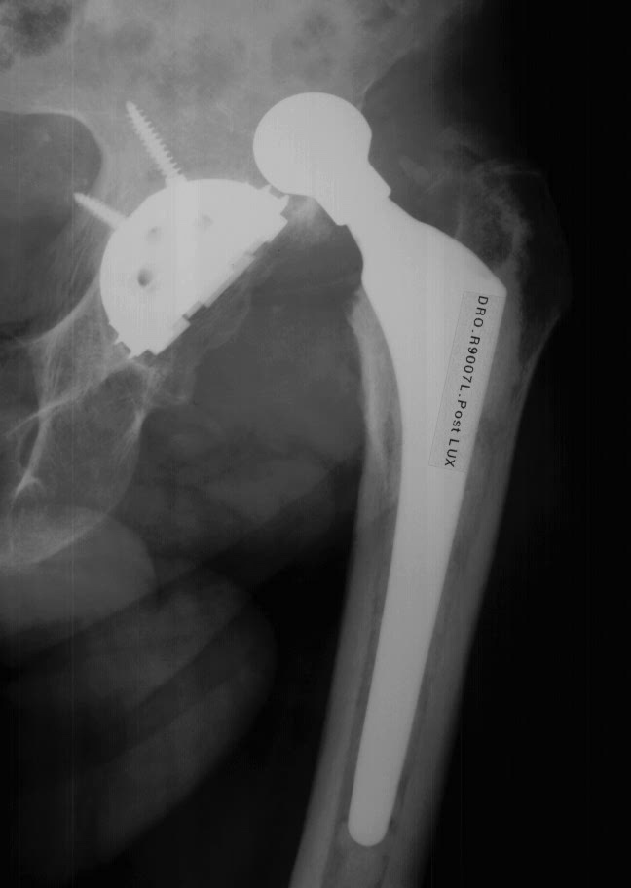
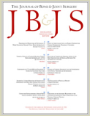
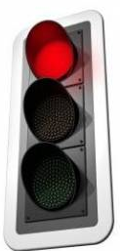
DISLOCATIONS !!!...
2009 report :
1st cause of revisions
The Epidemiology of Revision Total Hip Arthroplasty in the United States
Bozic, K.., JBJS Am 2009
" … The most common causes of revision were instability/dislocation (22.5%), mechanical loosening (19.7%), and infection (14.8%)."

Slide 10

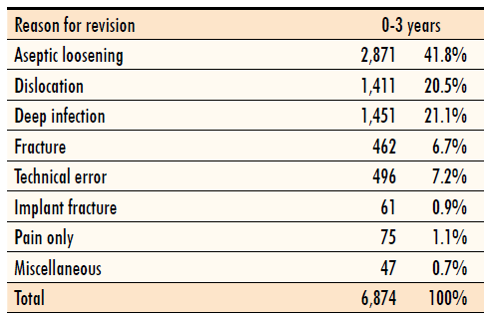
DISLOCATIONS !!!...
2009 report :
2nd cause/ 3yrs
1/5 of revisions

Slide 11

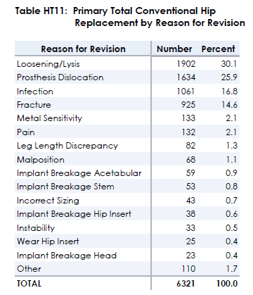
DISLOCATIONS !!!..
2011 report :
2nd cause
¼ of revisions

Slide 12


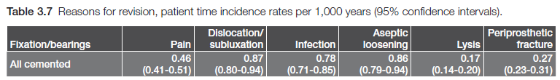
DISLOCATIONS !!!...
2012 report :
2nd cause
Global | 0,91 | 1,14 | 0,92 | 1,25 | 0,20 | 0,55

Slide 13
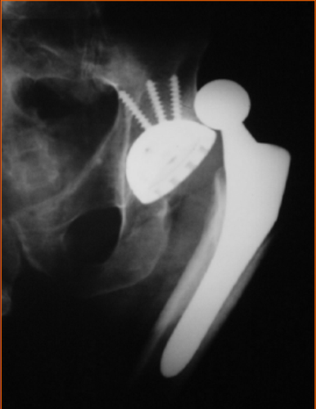
FACTEURS D’INSTABILITE :
FACTEURS TECHNIQUES:
Voie d’abord
Diamètre de la tête
Qualité du positionnement
Expérience
Berry : JBJS am 2007 87 a:
APPROACH | 22 MM HEAD | 28MM HEAD | 32 MM HEAD
POSTERO LATERAL | 12.1 | 6.9 | 3.8
TRANSTROCHANTERIC | 3.5 | 3.5 | 2.8
ANTERIOR | 3.8 | 3.0 | 2.4
Notes:
13
La luxation est une complication fréquente de l’arthroplastie de hanche
Sa frequence est dans les études en moyenne de 2 à 3% des arthroplasties totales de hanche . Elle est bien plus fréquente lors des révisions au cours desquelles elle survient dans 10 à 20 pour cent des cas.
Les causes de luxation sont multiples
Leur fréquence est plus importante avec des têtes de petit diamètre et une approche postérolatérale

Slide 14

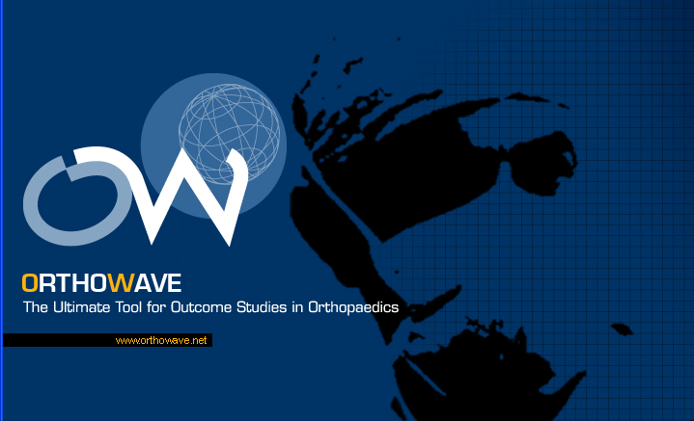
AGE / DISLOCATIONS
A prospective 24 years study (1987-2011) on our OrthoWave DataBase
Primary Hip replacement with Fixed Bearings
Prevalence of Dislocation and Revision due to dislocations in 2 Groups
  Over 70 yrs: 1634 hips (mean age 76.6 yrs) = OPG
  Under 60 yrs: 1030 hips (mean age 50.3 yrs) = YPG
Etude réalisée par le Dr J A Epinette

Slide 15
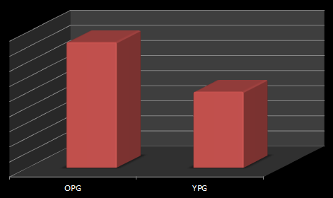


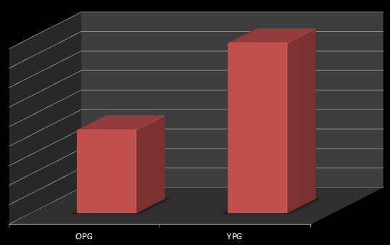

Dislocation Rates
4.16%
2,52%
Significantly more dislocations in the elder patients >70 yrs
Revision Rates
1.75%
However the revisions for recurrent dislocations were significantly more frequent < 60 yrs
0.86%

Slide 16
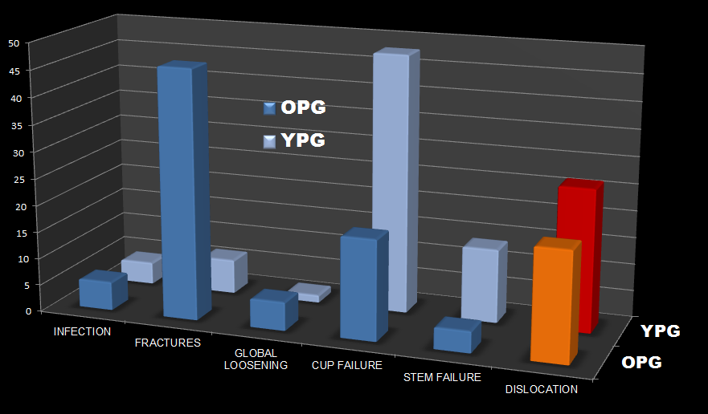
Dislocation
= second cause of revision in each group
26.5%
20.3%

Slide 17
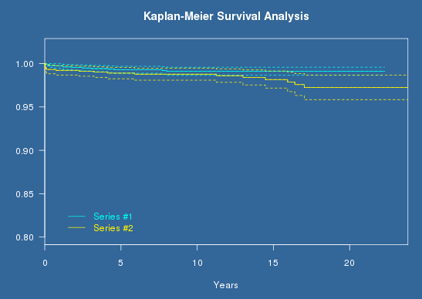



Kaplan-Meier Analysis:
Revision for Recurrent dislocations as end-point
@ 22 yrs: 99,1% (0.986- 0.996)
@ 23 yrs: 97.2% (0.958- 0.987)
Log-rank = 4.36
P-value: 0.0367 (+) p < 0,05

Slide 18
The problem ?
Dislocations and Revision due to recurrent dislocations:
  More dislocations in the elderly
  However…
  Higher revision burden in young patients (2.8% vs. 0.9%, p<0.05)
  Revision for dislocations are the second cause for revision <60 yrs

Slide 19
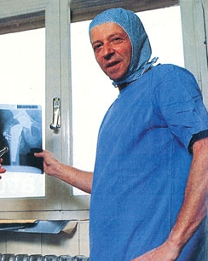
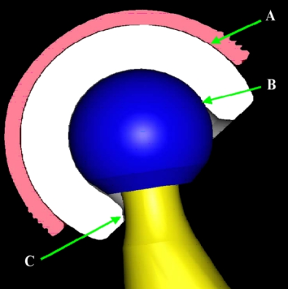
THE SOLUTION ?
DUAL MOBILITY CUPS
Principles & Results
Gilles Bousquet
France -1974
Stroh A et al. 2012
Dual-mobility prostheses (tripolar) = greater stability with an increased range-of-motion, along with potentially reduced wear.
Mean overall dislocation rate = 0.1% for primary total hip arthroplasty and 3.5% for revisions, compared with 2-7% for standard primary total hip arthroplasties and up to 16% for revisions. "

Slide 20
LUXATIONS:
RESULTATS EN CHIRURGIE DE PREMIERE INTENTION < 1 %
( Moyenne de 2 à 4% avec des cups standards)
Prévention de la luxation
AUBRIOT 1993 100 PTH 0%
FARIZON 1998 144 PTH 0.7 %
VANEL 2003 127 PTH ( fractures) 1.27% ( 8/14%)
BEJUI-HUGUES 2006 167 PTH 0%
PHILIPPOT 2006 70 PTH < 50 ANS 0%
GUYEN 2007 163 PTH 0%
BAUCHU 2008 150 PTH 0%
PHILIPPOT 2008 438 PTH 0%
BERACASSAT 2010 422 PTH 0%
SYMPOSIUM SOFCOT 2009 214 PTH (fractures) 1.4%
SYMPOSIUM SOFCOT 2009 3473 PTH 0.42%
Notes:
20
Les résultats des cupules double mobilité sur la prévention de la luxation ont souvent été rapportés et confirment le bon fonctionnement de ce principe que ce soit dans les arthroplasties de première intention y compris chez les sujets de moins de 50 ans ou

Slide 21
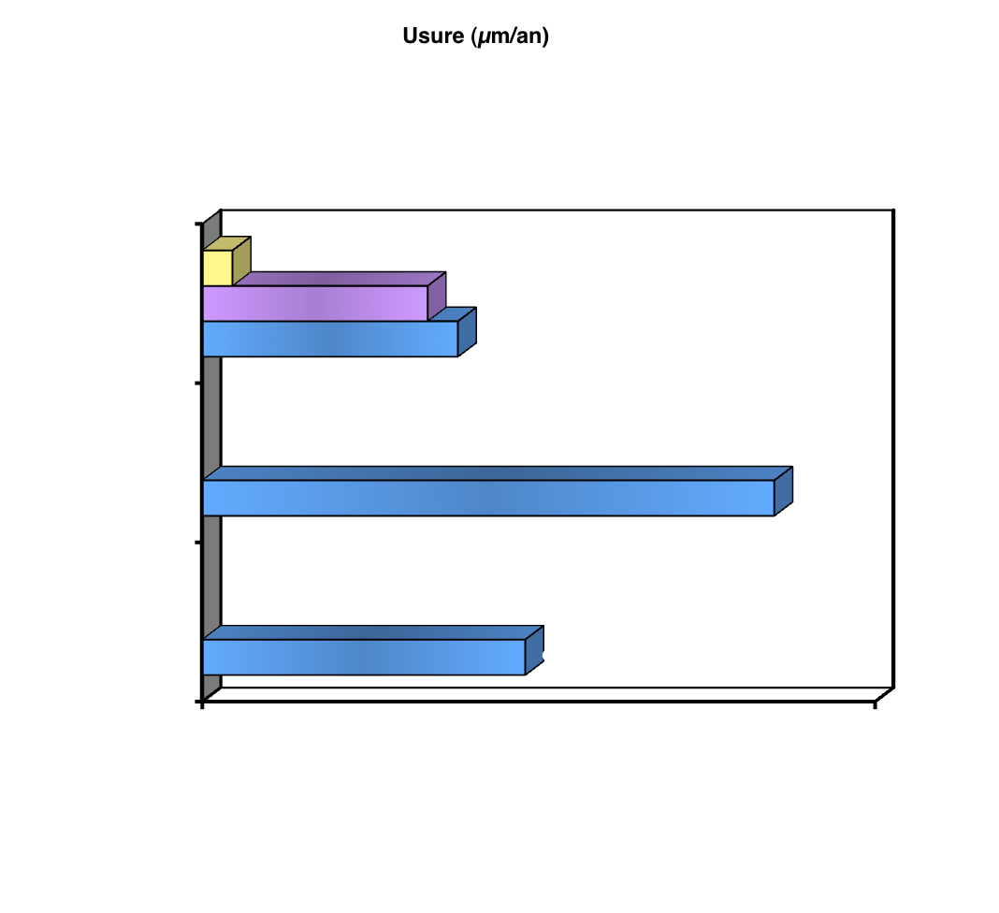
FIABILITE: USURE
Petite Articulation (µm/an)
Grande Articulation (µm/an)
Globale (µm/an)
St Etienne 2000
9
Double mobilité
intermédiaire
Charnley
D’après Adham Ph., Fessy M.H.
SOFCOT 2000
(µm/year)
Notes:
Si chacune des 2 articulations avait sa mobilité entière et indépendante, il y aurait effectivement un risque important d'usure.
Mais en pratique les 2 articulations sont très dépendantes en phase dynamique (en charge et en mobilité) C’est la petite articulation qui est toujours la première à se mobiliser. La seconde articulation n'est sollicitée que secondairement et est donc très peu sollicitée, ce qui explique la faible usure à ce niveau.
L’étude de l’école de Saint Etienne a d’ailleurs bien montré que l’usure mesurée avec les cotyles double mobilité peut être comparée à celle des cupules de Charnley.

Slide 22
Fiabilité: survie
AUBRIOT 1993 100 PTH 97 % à 5 ans
FARIZON 1998 135 PTH 95.4 % à 10 ans
PHILIPPOT 2004 106 PTH 94.6% à 10 ans
PHILIPPOT 2006 100 PTH avant 50 ans 95% à 10 ans
LAUTRIDOU SOFCOT 2007 437 PTH 84.4% à 15 ans
SYMPOSIUM SOFCOT 2009 3473 PTH 95.24% à 10 ANS

Slide 23

DUAL MOBILITY CUPS
Issues in "classic" DM Cups
438 dual mobility socket @ 17-yr follow-up
R. Philippot – OTSR 2008
Intra-prosthetic dislocation
Loosening
Wear
2,97%
5,25%
1,60%
"According to numerous reports the dual-mobility cup appears to offer a safe, effective and durable solution to hip instability.
However, significant complications have been highlighted after the use of first generation cups, which were mainly due to
premature wear of the polyethylene, leading to intraprosthetic dislocations
or insufficient means of fixation.

Slide 24
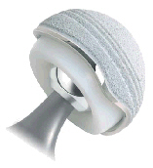
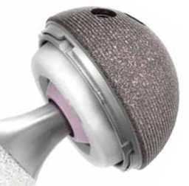
DUAL MOBILITY CUPS
New Deal with "modern" DM Cups
✗
"classic"
✓
Loosening
No Performing Interface
No appropriate substrate
Excellent Bony Ongrowth
HA on SecureFit / Tritanium
Excellent Substrate :
Porous coated

Slide 25
DUAL MOBILITY CUPS
New Deal with "modern" DM Cups
✗
"classic"
✓
Loosening
Better Design
Better locking mechanism (no additional ring to ensure retention)
1/3 "pure wear" retention device
1/3 loosening 3rd wear (UHMPE)
1/3 impingement fibrosis/bone

Slide 26
DUAL MOBILITY CUPS
New Deal with "modern" DM Cups
✗
"classic"
?
Wear
Regular UHMPE as in Fixed Bearings cups
Can New Bearings can meet the challenge ?

Slide 27
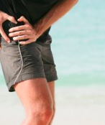
EARLY PAIN

Slide 28
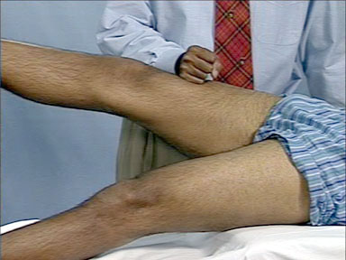
PSOAS impingement syndrome
4,3% ( S Bricteux 2001 T Ala Eddine 2001)
1% causes of revision: (J Clohisy 2004)
SYMPOSIUM SOFCOT 2009 : 2,1% ( F Farizon)
First cause of late complication
2,1%
F FARIZON
SOFCOT 2009
Notes:
The syndrome of conflict with the psoas is not exceptional
it is the first cause of late complications according to cases reported in SOFCOT 2009

Slide 29
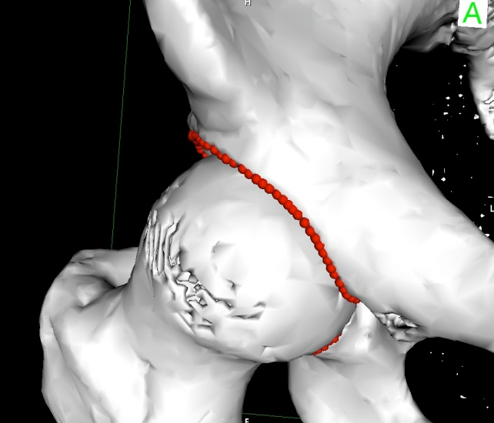
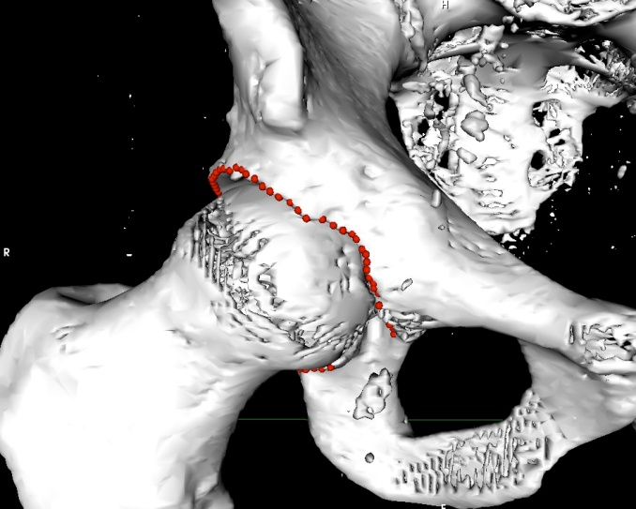
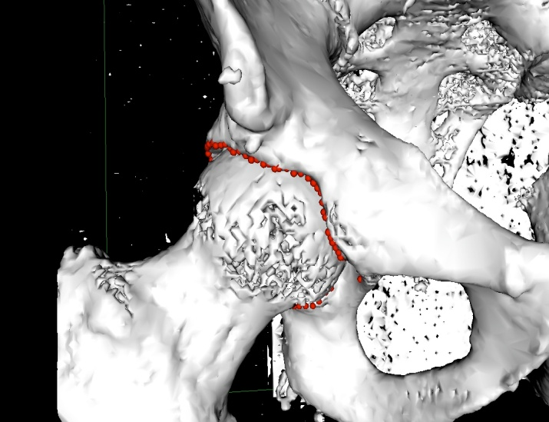
ETUDE SCANOGRAPHIQUE (226 Sc.)
E.Vandenbusche (Paris) – R. Béracassat (Alès ) - Logiciel Osirix
Incurvée (>2mm) (79%)
22% DE FORMES A RISQUE
TROIS FORMES DE
LA VALLEE DU PSOAS
Angulaire en V (11%)
Irrégulière (11%)
Notes:
Les résultats ont montré que la projection polaire du rebord acétabulaire ressemble à une sinusoïde asymétrique constituée de successions de 3 sommets et de 3 dépressions. La courbe part à gauche de la corne postérieure pour aller à droite vers la corne antérieure.

Slide 30
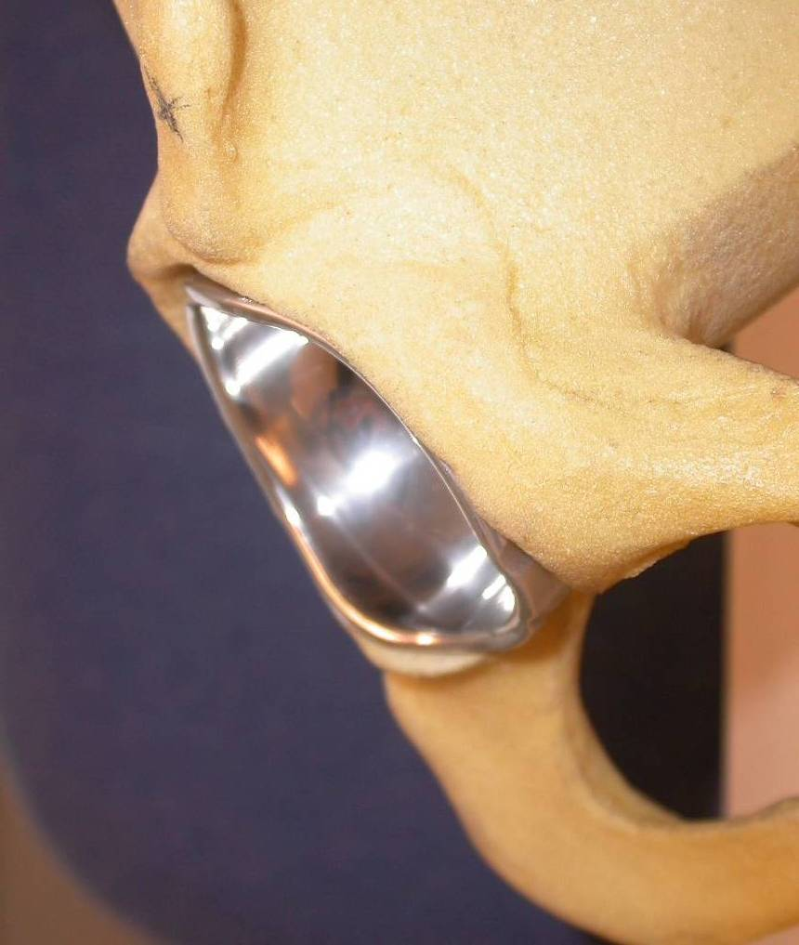
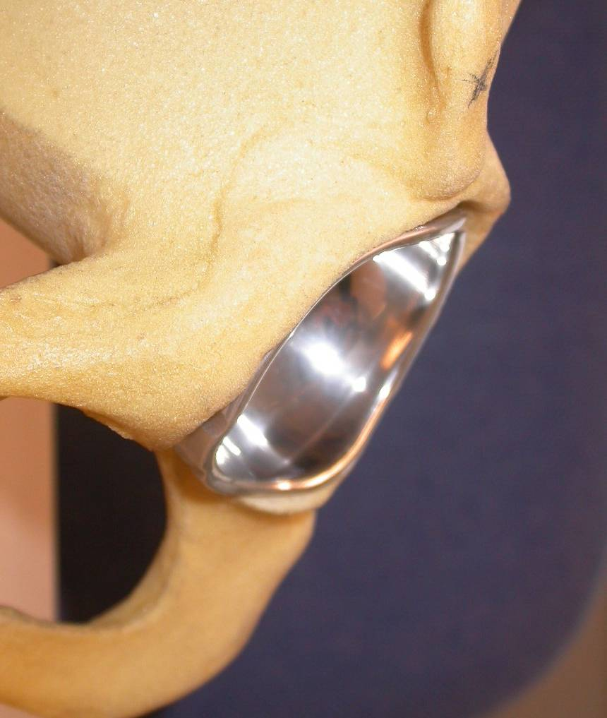
Adapter le design de la cupule à l’anatomie
La Reconstruction Anatomique Droite et Gauche respecte la vallée du Psoas
Notes:
This is why we designed a new anatomic profile. The ADM cup is the first right and left anatomic cup with an anterior notch THAT respects the anterior rim of the acetabulum and thus prevents any conflict with the ileo psoas muscle .
30

Slide 31
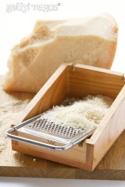


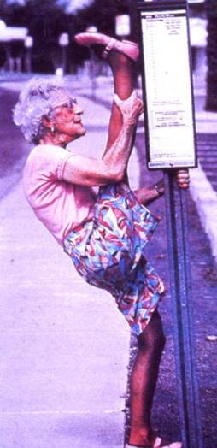
Matériaux, couples de frottement
USURE
RESISTANCE MECANIQUE
OXYDATION
STABILITE

Slide 32
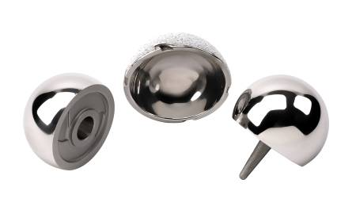
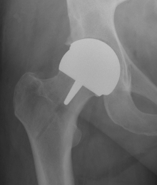
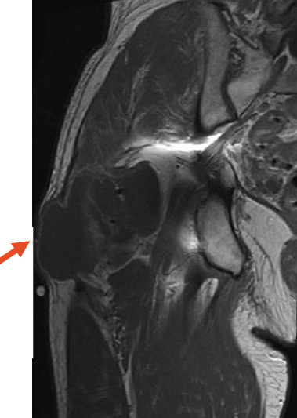
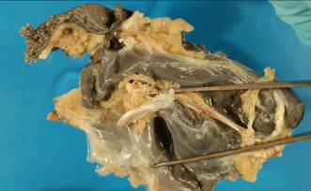
Métal / Métal
Possible anatomical restoration
The larger heads (44/50)
Bone preservation - Resurfacing
low wear
But
Head / Neck ratio : neck fractures
Do not allow dual mobility (dislocations)
cost
Pseudo tumors
Survival curve
Release of metal (Co Cr blood levels +++)

Slide 33
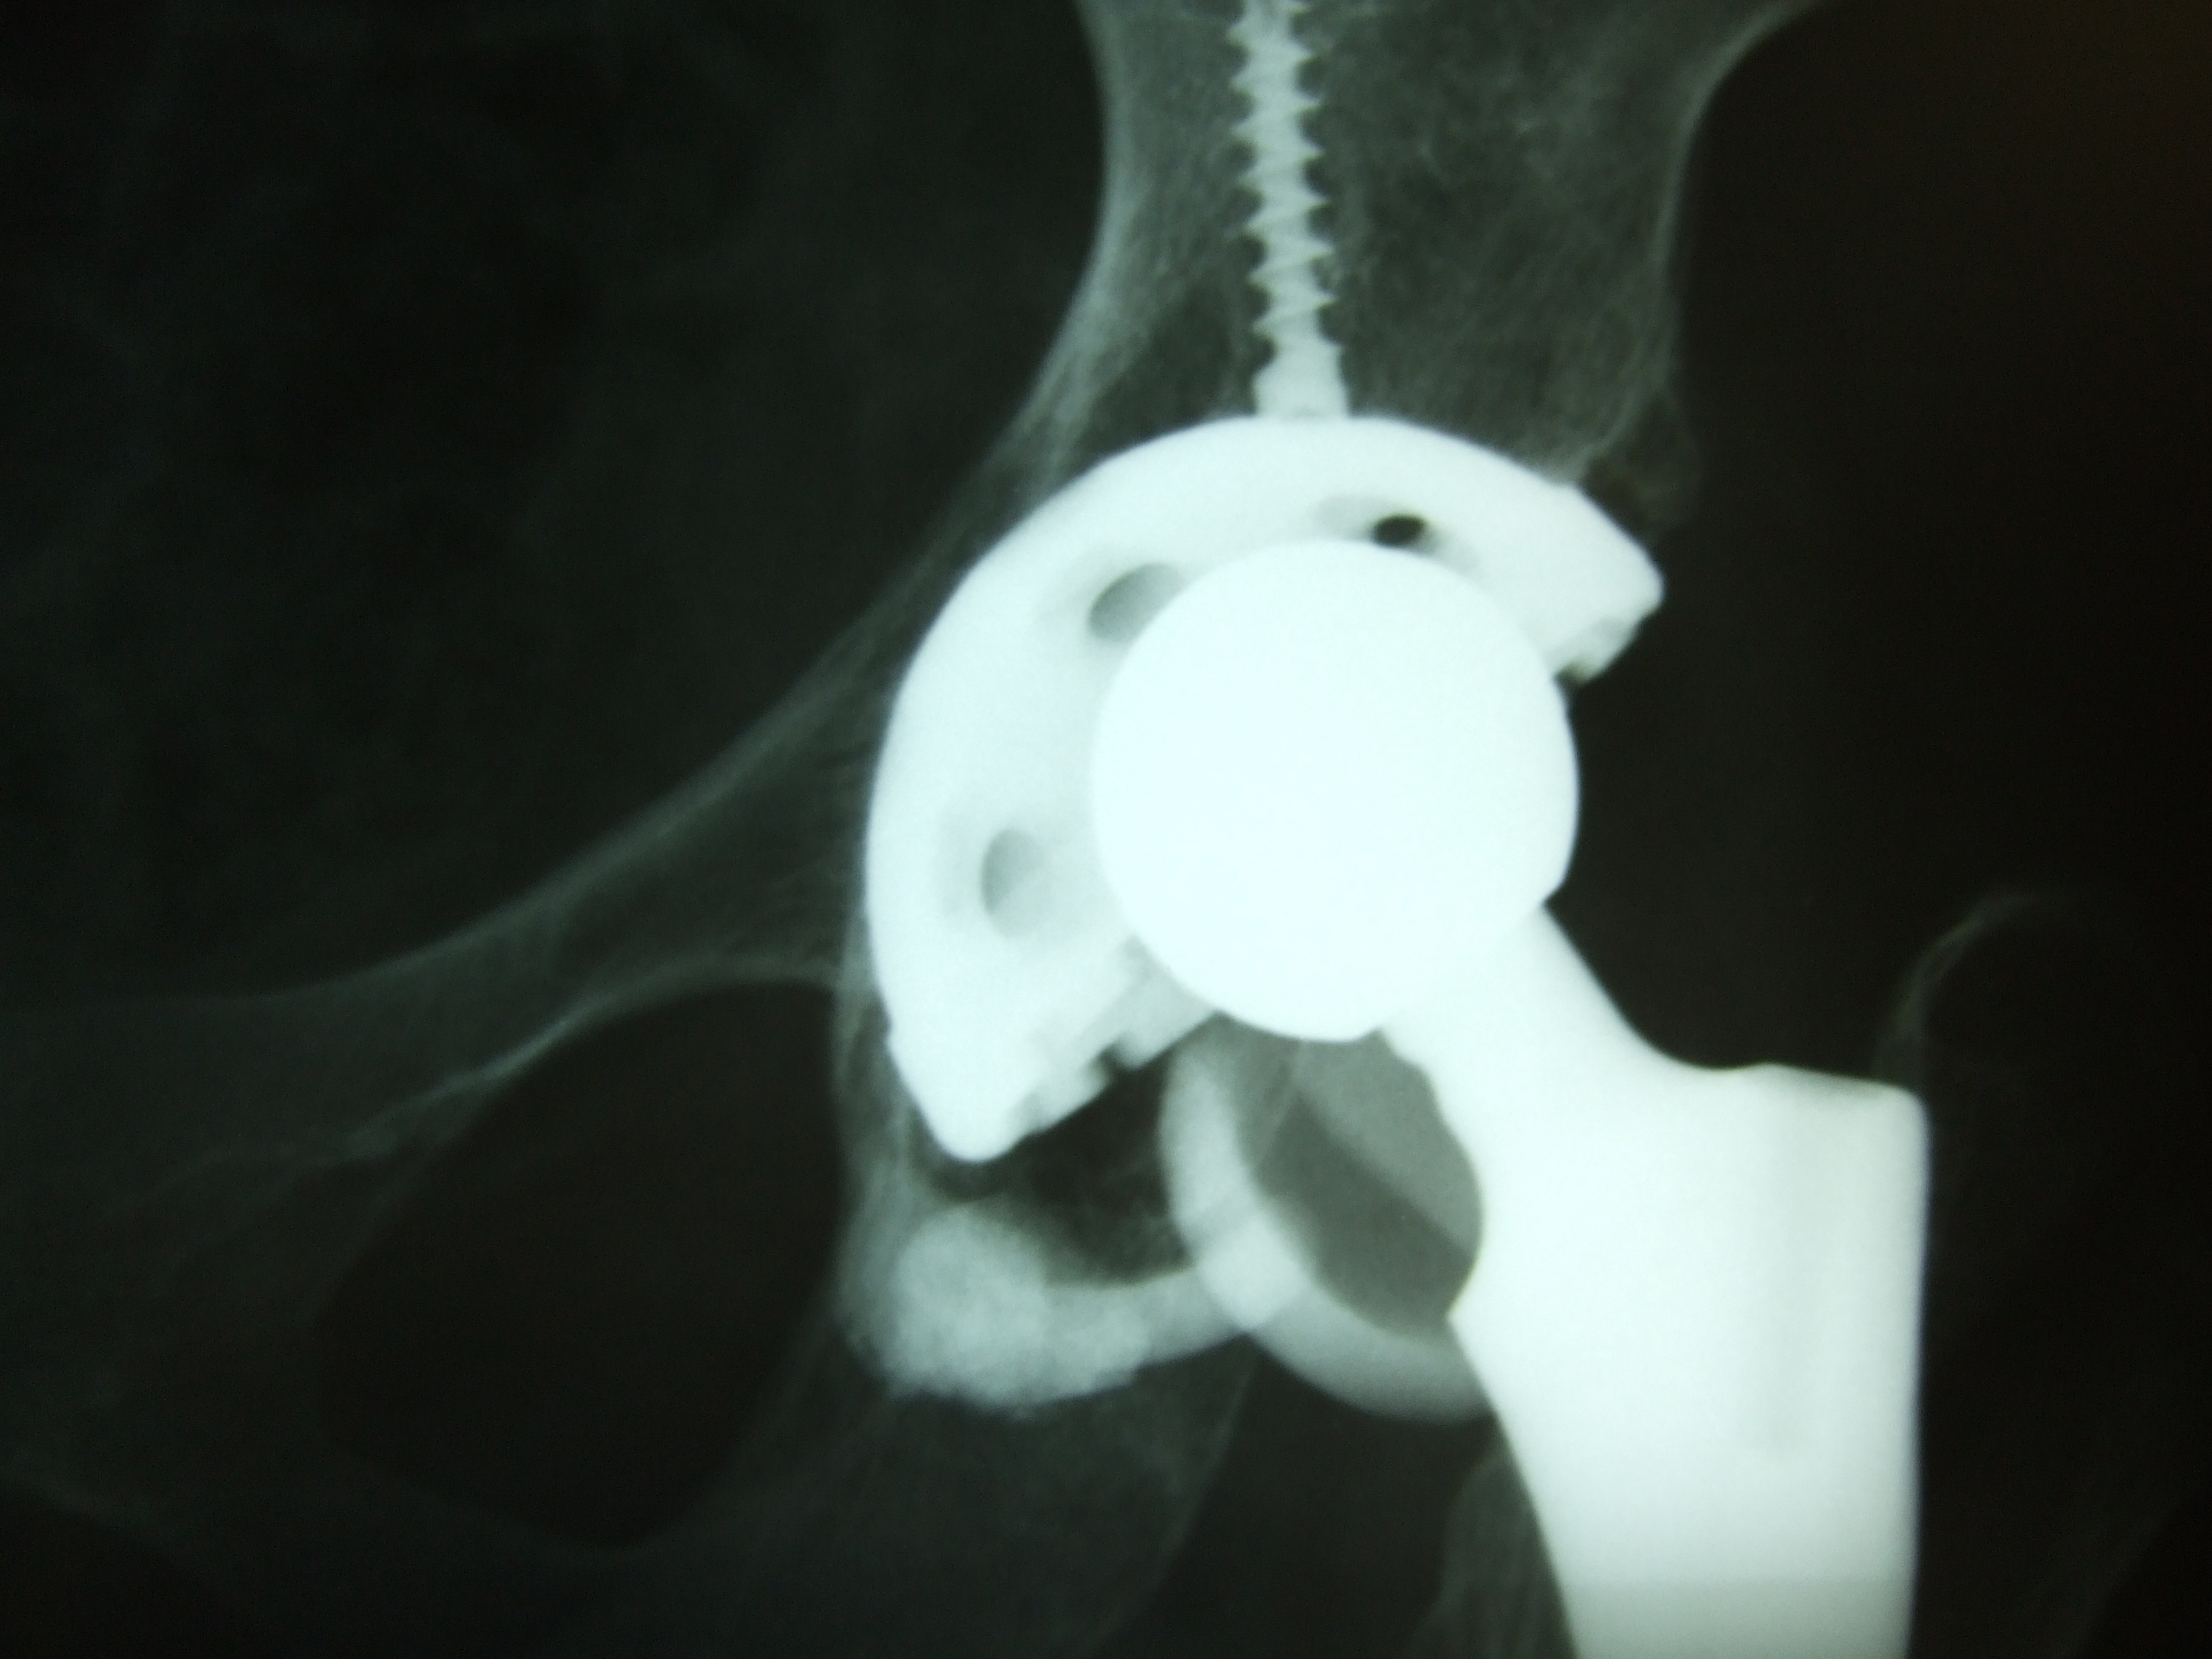
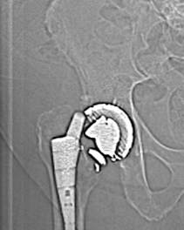


Ceramic / Ceramic

Slide 34

X3™ Wear resistance
Oxydation tests
Very low rate of free radicals in the X3 compared to other tested PE
- 97%
- 90%

Slide 35
Mechanical Strength
-35 %
Remelting after irradiation significantly changes the cristallinity of PE
The more irradiated, the weaker is the mechanical strength of PE

Slide 36
Stress:
Survival tests after liner destructions

Slide 37



Alumine Alumine
X3®
Résistance à l’usure
FRACTURE
GRINCEMENT
Poly-éthylène hautement réticulé
Métal Métal
IONS
GRINCEMENT
USURE
P.E conventionnel
coût

Slide 38


DM + HXLPE : The Challenger !...
CoC
MoM
X3
X
May be the future Gold Standard in acetabular replacement ???

Slide 39
Usually Patients selection for DM are strictly limited to old or fragile patients “at risk”,
>70 yrs …

Slide 40


These limitations can be seen as obsolete with modern devices !!!
!
Notes:
Stirling moss et grosjean

Slide 41



Fixation of these new DM cups of modern generations compare favorably with fixed bearing cups !

Slide 42


We really believe in new generations of stabilized HXLPE!...

Slide 43

"This study set out to evaluate the wear performance of the dual mobility design under several aggressive testing conditions
and revealed that the dual mobility hip with sequentially crosslinked polyethylene was highly wear resistant under all test conditions.
All wear rates from each test were low when compared to the wear rate of a clinically successful single articulation hip with conventional polyethylene"

Slide 44



The OrthoWave™ Hip online Data Base
  All related data are prospectively collected online through the ADM linked databases from the involved surgeons.
  This EDC system allows for results and analyses on real time, available for any presentation or articles.

Slide 45
1 - Why Publishing on Instability in THAs?
  Instability is a major issue nowadays and Mobile Bearings can be an efficient option
  The burden of revisions due to instability is not restricted to the Elderly, but also significantly addresses young and active patients
  So far, DM cups keep allowed to patients >70 yrs as a salvage procedure : major limitations in the use of MBH !!!
2 - Why Publishing on ADM Cups ?
  All published papers report on 1st generation of DM cups
  Modern MB implants design and rationale can fix all issues met with previous generation of DM cups
  Affording both an anatomical design AND appropriate cross-linked Polyethylene, as ADM Cup does, can meet the challenge as the new Gold Standard in Cups ! …
Notes:
L’instabilité = question majeure posée Pb résolu
ADM relève le defi du gold standard

Slide 46

The Aim of the Study
"The long-term outcomes for second generation dual-mobility cup can be more promising, mostly addressing new polyethylene manufacturing techniques
With
second generation of cross-linked polyethylenes,
anatomical designs preventing from ilio-psoas tendon impingement,
and improvements in metal cup fixation"

Slide 47
Patients & Methods
The Series
”Five French Institutions, which have implanted the same HA-coated ADM cup, at 2- to 5-year follow-up, as a prospective multicenter consecutive study of 437 primary hips in 417 patients.
Primary surgeries between January 2007 and October 2010, two cohorts of patients according to their age at index surgery.
The “official” and currently used limit was 70 years as eligible for such a choice of implant, so we have defined two groups under versus over this threshold

Slide 48


Patients & Methods
Two comparative Groups
"Younger" patients /YPG (< 70 years of age, n = 112 hips, 106 patients - average age at 61.3 y; 42–69)
versus
"Regular" patients /RPG (≥ 70 years, n = 325 hips, 311 patients - average age at 78.6 y; 70–95).

Slide 49
Demographics
 |  | YPG: 112 | RPG:325
Gender | Male | 48,6 | 30,9
(%) | Female | 51,4 | 69,1
Aetiology | OA | 81,2 | 80,9
(%) | Necrosis | 9,8 | 4,6
 | Rheumatoid | 0 | 0,9
 | Post Tr Arthritis | 5,4 | 3,7
 | Revision/Bipolar | 0 | 0,9
 | CDH | 0,9 | 0
 | Acute Fracture | 0,9 | 5,9
 | Other | 1,8 | 3,1
Approach | Posterior | 99,1 | 99,7
 | Anterior | 0,9 | 0,3
Bone Quality | A: Dense | 30,4 | 10,5
 | B: Regular | 68,8 | 75,7
 | C: Poor | 0,9 | 13,8

Slide 50
Archiving
 |  | YPG: 112 | RPG:325
Archiving | On File | 95,5 | 92,7
 | Lost to Fup | 0 | 0,9
 | Dead | 2,7 | 5,2
 | Stem Retrival | 0,9 | 0,6
 | Cup Failure | 0 | 0,3
 | Stem Failure | 0,9 | 0,3

Slide 51
Complications & Adverse Effects
Complications | N Hips | Type of Event | YPG | RPG
N Hips | 437 |  | 112 | 325
DISLOCATIONS | 0 | Either Early or Late | 0 | 0
Reoperations | 5 (1.14%) | Femoral Shaft Fracture | 0 | 3
 |  | Heterotopic Ossifications | 0 | 1
 |  | Local infection( Lavage) | 0 | 1
Not Implant-related Revision | 3 (0;69%) | Accidental Femoral Fracture | 1 | 2
Implant -related Revision | 4 (0.92%) | Isolated Stem Revision | 1 | 1
 |  | Global Revision | 0 | 1
 |  | ADM MECHANICAL FAILURE | 0 | 1

Slide 52
Clinical results
 |  | YPG:78 | RPG: 264
Mean Fup | (in yrs) | 2,98 (2-4) | 3.21 (2-5) | P=0.0552 (NS)
HHS : Pain | None | 95.8 | 78.7
 | Slight | 4.2 | 13.2
 | Mild | 0 | 7.5
 | Moderate | 0 | 0.6
 | Marked | 0 | 0
 | Ilio-Psoas | 0 | 0
HHS: Subscores | Pain (/44) | 43.8 | 42.3 | P=0.011 (S)
 | Function (/47) | 45.5 | 41.1 | P< 0.001(S**)
HHS Total | PreOp (/100) | 41.8 | 34.5 | P< 0.001(S**)
 | Latestr Fup (/100) | 97.55 | 92.15 | P< 0.001(S**)
 | GAIN | 55.75 | 57.65
MDP Score | Latest Fup (/18) | 17.57 | 16.45 | p= 0.0105 (S)
WOMAC Score | Latest Fup (best=0) | 2.69 | 10.74 | p<0.001 (S**)
Notes:
N
%
Retrieved components
Comments
Cup
Stem
Both
Fractures (Vancouver type B2&B3)
17
1.48
1
12
4
4 global revisions, 1 acetabular and 12 isolated femoral revisions, after accidental falls
Recurrent dislocation
5
0.44
4
1
3 cup exchanges and 1 isolated femoral revision due to recurrent dislocation (implant malposition)
Technical errors: Postop fracture
2
0.17
1
1
Technical error at surgery (inappropriate stem size), with early sinking and femur fracture, leading to global revision in one case, and isolated femoral revision in the other.
Wear and lysis
2
0.17
1
1
One global revision following recurrent dislocation, and potentially third-body wear, at Year 6; and 1 worn cup with extensive osteolysis behind the cup
Cup loosening
6
0.52
6
Aseptic loosening of cups at a mean follow-up of 5.6 (3 to 7) yrs

Slide 53

Radiological results
No line around HA-coated portion
No pending loosening
Optimal Bony ongrowth in all cases
Notes:
N
%
Retrieved components
Comments
Cup
Stem
Both
Fractures (Vancouver type B2&B3)
17
1.48
1
12
4
4 global revisions, 1 acetabular and 12 isolated femoral revisions, after accidental falls
Recurrent dislocation
5
0.44
4
1
3 cup exchanges and 1 isolated femoral revision due to recurrent dislocation (implant malposition)
Technical errors: Postop fracture
2
0.17
1
1
Technical error at surgery (inappropriate stem size), with early sinking and femur fracture, leading to global revision in one case, and isolated femoral revision in the other.
Wear and lysis
2
0.17
1
1
One global revision following recurrent dislocation, and potentially third-body wear, at Year 6; and 1 worn cup with extensive osteolysis behind the cup
Cup loosening
6
0.52
6
Aseptic loosening of cups at a mean follow-up of 5.6 (3 to 7) yrs

Slide 54
Survivorship Analysis
Notes:
N
%
Retrieved components
Comments
Cup
Stem
Both
Fractures (Vancouver type B2&B3)
17
1.48
1
12
4
4 global revisions, 1 acetabular and 12 isolated femoral revisions, after accidental falls
Recurrent dislocation
5
0.44
4
1
3 cup exchanges and 1 isolated femoral revision due to recurrent dislocation (implant malposition)
Technical errors: Postop fracture
2
0.17
1
1
Technical error at surgery (inappropriate stem size), with early sinking and femur fracture, leading to global revision in one case, and isolated femoral revision in the other.
Wear and lysis
2
0.17
1
1
One global revision following recurrent dislocation, and potentially third-body wear, at Year 6; and 1 worn cup with extensive osteolysis behind the cup
Cup loosening
6
0.52
6
Aseptic loosening of cups at a mean follow-up of 5.6 (3 to 7) yrs

Slide 55
Discussion
Excellent Clinical Results confirmed
  No dislocation reported within each of the two cohorts at latest follow-up, which can state that hip instability can be successfully prevented by so called “modern DM cups”
  Of the entire group, only 2 cup retrievals were reported of which only one of them (0.23%) was a true failure (poor indication+++ in very soft bone!)
  No psoas tendon impigement thanks to the anatomical design of ADM
  Our clinical results are superior to those in the literature with “old DM cups”, and must open a new era in acetabular replacement, with widely extended indications thanks to stabilized HXLPE (X3)
  Encouraging results so far, ongoing studies in young patients under 55 years of age, and expected large increase in ADM implantations
Notes:
N
%
Retrieved components
Comments
Cup
Stem
Both
Fractures (Vancouver type B2&B3)
17
1.48
1
12
4
4 global revisions, 1 acetabular and 12 isolated femoral revisions, after accidental falls
Recurrent dislocation
5
0.44
4
1
3 cup exchanges and 1 isolated femoral revision due to recurrent dislocation (implant malposition)
Technical errors: Postop fracture
2
0.17
1
1
Technical error at surgery (inappropriate stem size), with early sinking and femur fracture, leading to global revision in one case, and isolated femoral revision in the other.
Wear and lysis
2
0.17
1
1
One global revision following recurrent dislocation, and potentially third-body wear, at Year 6; and 1 worn cup with extensive osteolysis behind the cup
Cup loosening
6
0.52
6
Aseptic loosening of cups at a mean follow-up of 5.6 (3 to 7) yrs

Slide 56

Porous coated + HA
Dual mobility
A D M
The only
Anatomic design
HXLPE

Slide 57


Slide 58


SO… I nowadays implant this new generation of ADM/X3 for ALL my patients

Slide 59

Phew… That’s all !

