Slide 1
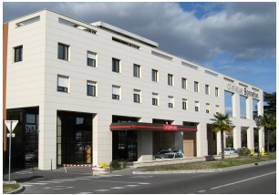
Anatomic Dual Mobility cup Tips and tricks
Docteur Richard BERACASSAT
Alès – France
Stryker meeting
EFORT – Copenhaguen ,
2 june 2011

Slide 2
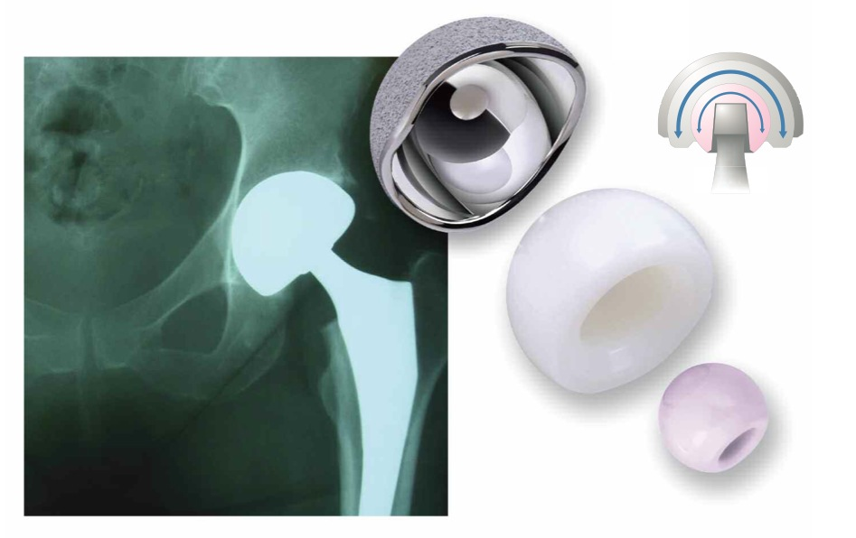
What is ADM® Cup?
Dual mobility cup / mobile bearing
The only anatomical acetabular cup

Slide 3
Why ADM ?
MAIN PROBLEMS FOR HIP SURGEONS:
INSTABILITY
WEAR
PAIN

Slide 4
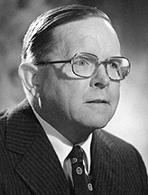
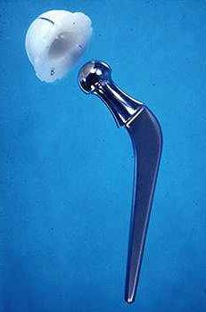
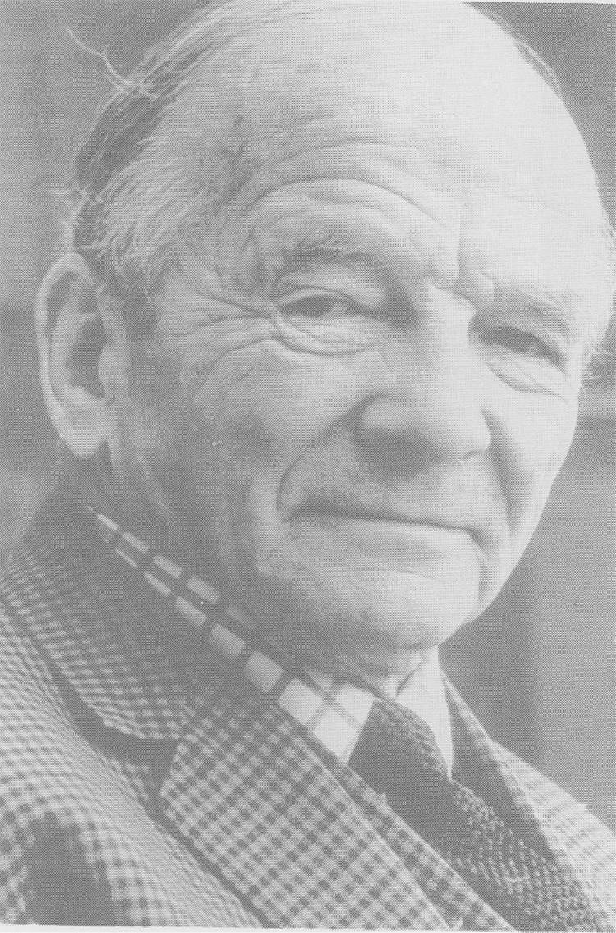
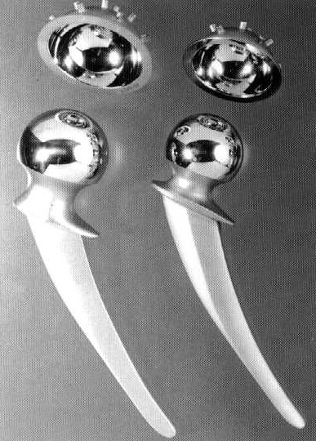
Why Dual Mobility ?
Purpose: Combines the advantages of
Low PE Wear:
Low friction
Stability of the join
Big head
John Charnley
Kenneth Mc Kee
Notes:
Le principe de la double mobilité est de bénéficier d'une usure réduite de l'insert polyéthylène dans un principe de " low friction " telle que l'avait décrit Charnley, et de procurer une stabilité intrinsèque de l'articulation en réimplantant une "tête fémorale" aux dimensions proches de l'anatomie originelle du patient, selon le principe de McKee-Farrar.

Slide 5


30 Years of clinical successful history
Pr. Gilles Bousquet
1936 - 1996

Slide 6

DUAL MOBILITY
2 Joints
A : Internal (small)
B : External (large)
Notes:
Le système à double mobilité se compose d'une cupule métallique et d'un insert polyéthylène mobile dans la cupule.
C’est la combinaison de deux articulations qui permet une meilleure mobilité tout en assurant une plus grande stabilité
On se trouve en présence de 2 articulations concentriques
La première interne, petite, entre la tête de la tige fémorale et l’insert
La seconde externe plus large entre l’insert en polyéthylène et la cupule.

Slide 7
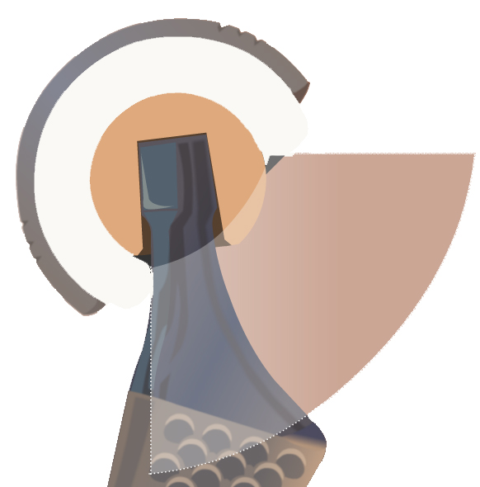
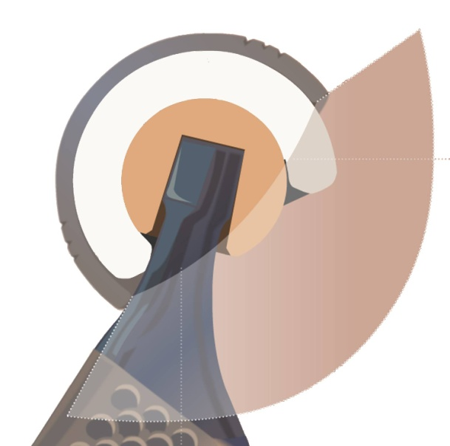
Dual mobility = More stability + More mobility
Addition of two mobility tapers which delays the dislocating lever effect
Internal mobility taper
Head 22.2mm α = 51°
Head 28mm α = 76°
External mobility taper
Cup OD 44mm β = 126°
Cup OD 65mm β= 140°
Constant for a given head/neck ratio
Increases with the cup diameter
Notes:
En pratique, la double mobilité fonctionne en agissant sur les deux facteurs principaux responsables de la luxation. En effet, non seulement il existe une augmentation de la distance parcourue par la tête avant de sortir de l’insert, et mais aussi, le bras de levier mis en action lorsque le col de la prothèse est en contact avec le bord de la cupule métallique est retardé ce qui diminue les risques de luxation.

Slide 8
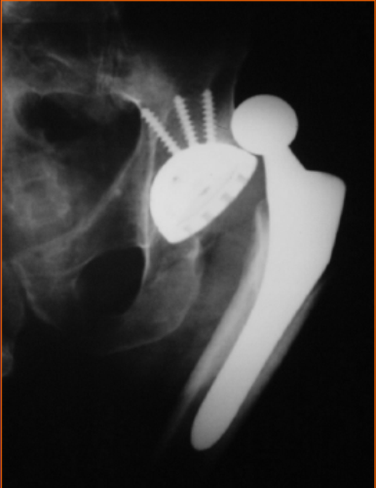
Dislocation
Primary THP: 2 – 3% ( 0.4 – 11%)
Fractures : 8 – 14 %
Revision : 10 – 20 %
Recurrence: 20 – 30 %
11 % causes of revision ( hip swedish register)
18% revisions before 5 y.( SOFCOT 2007)

Slide 9
DISLOCATIONS: D.M. RESULTS IN PRIMARY SURGERY < 1 %
Prévention de la luxation
FARIZON 1998 144 THR 0.7 %
VANEL 2003 127 THR ( fractures) 1.27% ( 8/14%)
AUBRIOT 1993 100 THR 0%
BEJUI-HUGUES 2006 167 THR 0%
PHILIPPOT 2006 70 THR < 50 Y 0%
GUYEN 2007 163 THR 0%
BAUCHU 2008 150 THR 0%
PHILIPPOT 2008 438 THR 0%
BERACASSAT 2009 683 THR 0%
SYMPOSIUM SOFCOT 2009 214 THR (fractures) 1.4%
SYMPOSIUM SOFCOT 2009 3473 THR 0.42%
Notes:
9
Les résultats des cupules double mobilité sur la prévention de la luxation ont souvent été rapportés et confirment le bon fonctionnement de ce principe que ce soit dans les arthroplasties de première intention y compris chez les sujets de moins de 50 ans ou dans les fractures du col

Slide 10
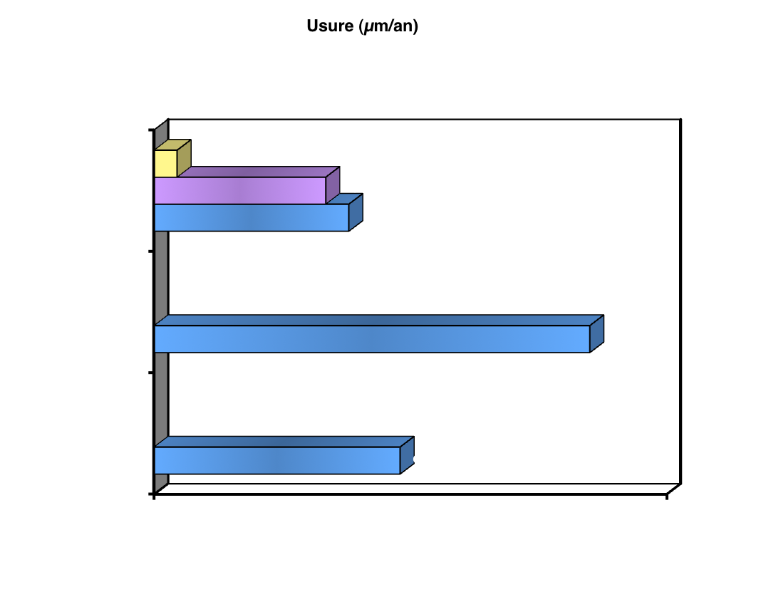
WEAR
Small join (µm/an)
Large join (µm/an)
Global (µm/an)
St Etienne 2000
9
Dual mobility
Bi-polar
Charnley
Adham Ph., Fessy M.H.
SOFCOT 2000
(µm/year)
Notes:
Si chacune des 2 articulations avait sa mobilité entière et indépendante, il y aurait effectivement un risque important d'usure.
Mais en pratique les 2 articulations sont très dépendantes en phase dynamique (en charge et en mobilité) C’est la petite articulation qui est toujours la première à se mobiliser. La seconde articulation n'est sollicitée que secondairement et est donc très peu sollicitée, ce qui explique la faible usure à ce niveau.
L’étude de l’école de Saint Etienne a d’ailleurs bien montré que l’usure mesurée avec les cotyles double mobilité peut être comparée à celle des cupules de Charnley.

Slide 11
Reliability: Good survival rate
AUBRIOT 1993 100 THR 97 % à 5 y
FARIZON 1998 135 THR 95.4 % à 10 y
PHILIPPOT 2004 106 THR 94.6% à 10 y
PHILIPPOT 2006 100 THR before 50 y. 95% à 10 y
LAUTRIDOU SOFCOT 2007 437 THR 84.4% à 15 y
SYMPOSIUM SOFCOT 2009 3473 THR 95.24% à 10 y
Notes:
La survie de ces prothèse est tout à fait équivalente aux meilleurs résultats publiés avec la simple mobilité

Slide 12
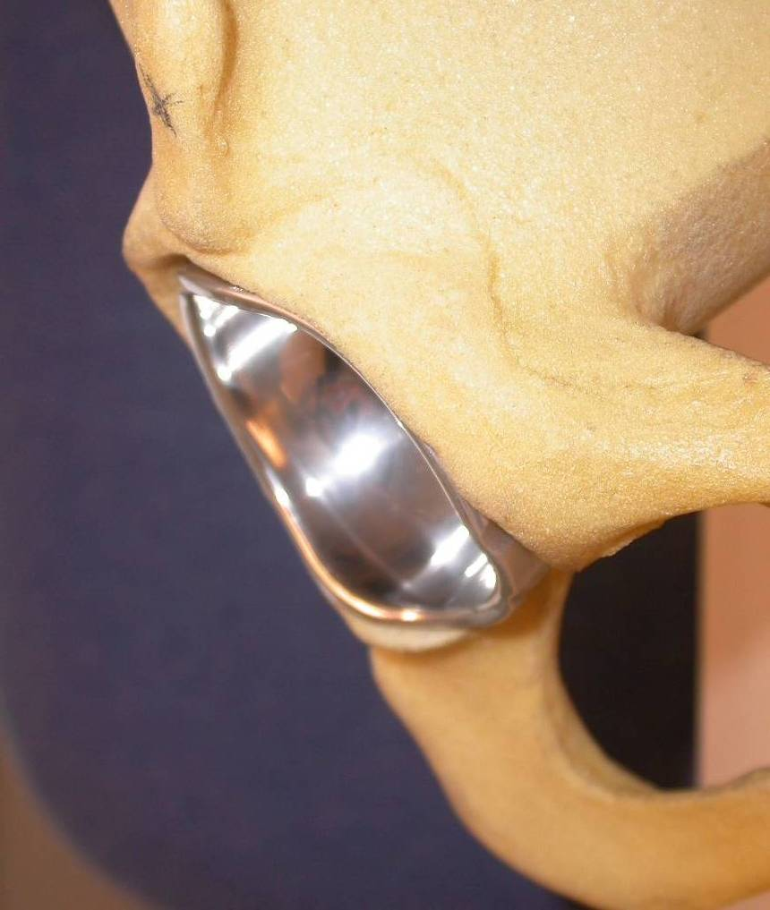
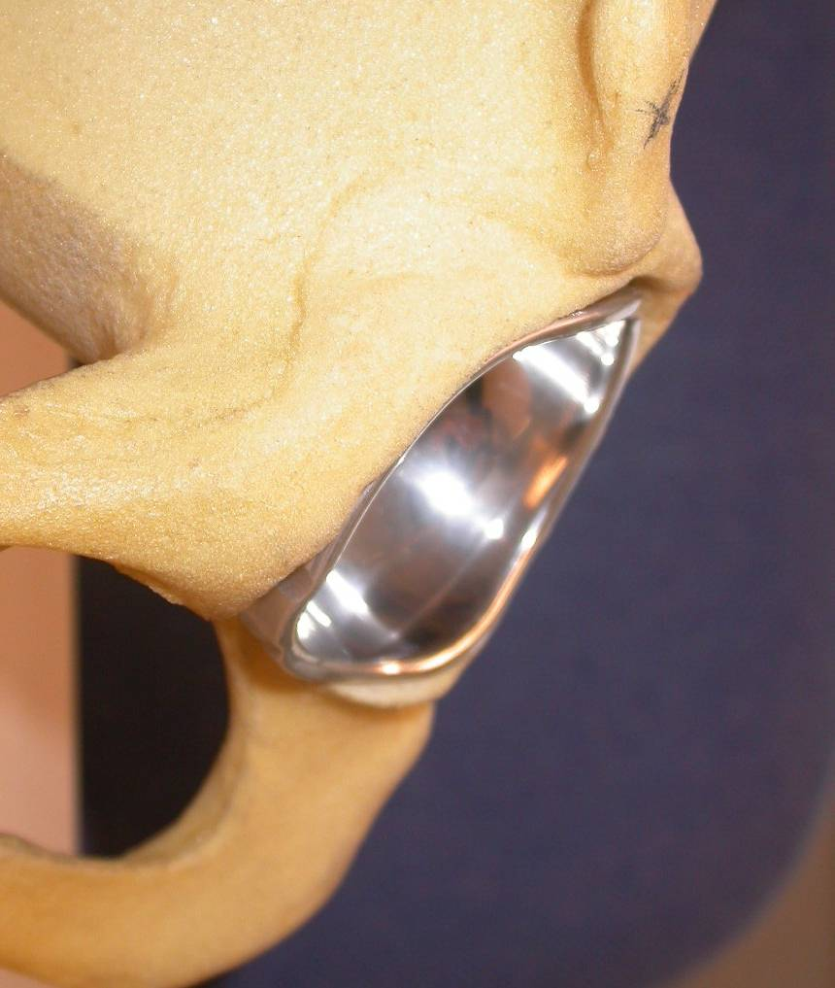
REST
Why Anatomic design ?
Anterior Notch respects ilio-psoas valley
Press fit 1.5 mm
Same porous coating + HA, as Trident – cup
Notes:
This is why we designed a new anatomic profile. The ADM cup is the first right and left anatomic cup with an anterior notch THAT respects the anterior rim of the acetabulum and thus prevents any conflict with the ileo psoas muscle .
12

Slide 13
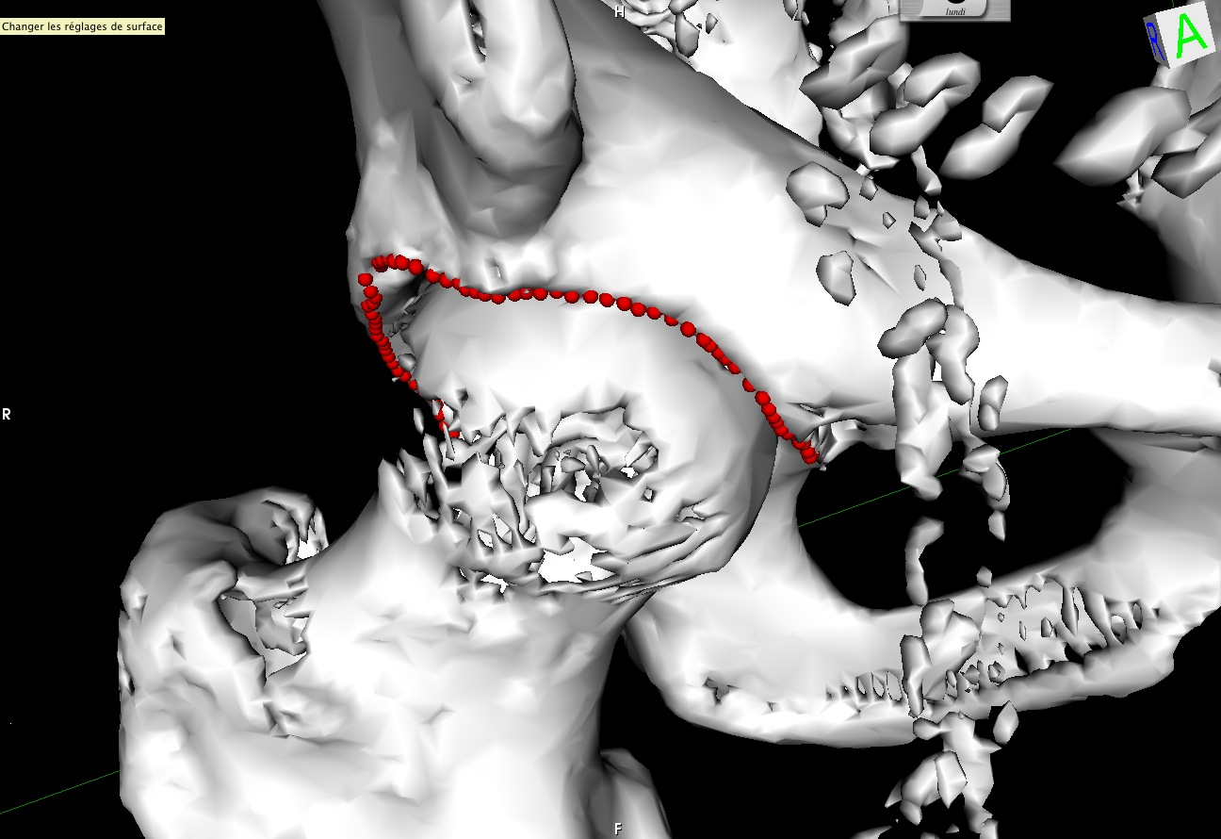
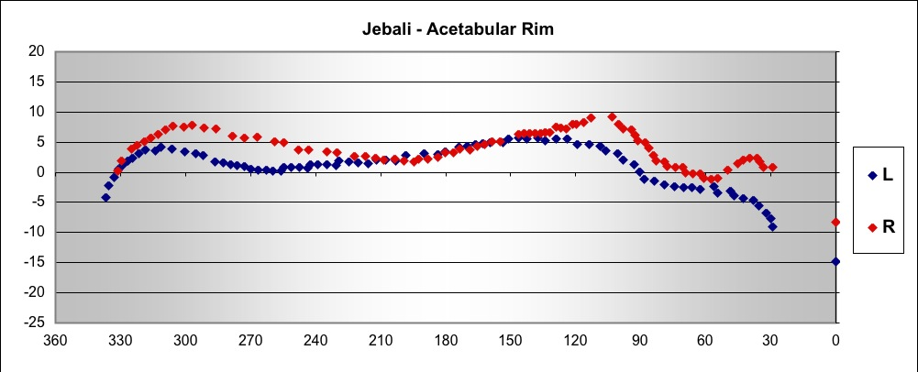
Anatomic study: Pr E. Vandenbusche- Paris
Navigation & CT scan and Osirix software
Acetabular rim is an asymetric succession of 3 pikes and 3 valleys
Ilio-psoas valley is 5 mm deep (2 - 10)
Always under the equatorial level : average=4 mm,
(3 - 15 mm)
Notes:
En conclusion,
Le rebord acétabulaire est une succession asymétrique de 3 pics et 3 vallées.
La vallée du psoas a une profondeur de 3 à 5 mm.

Slide 14
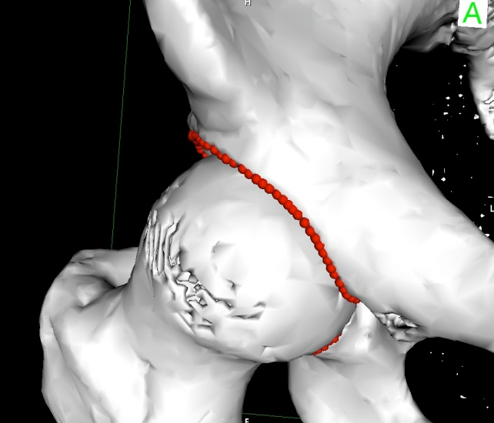
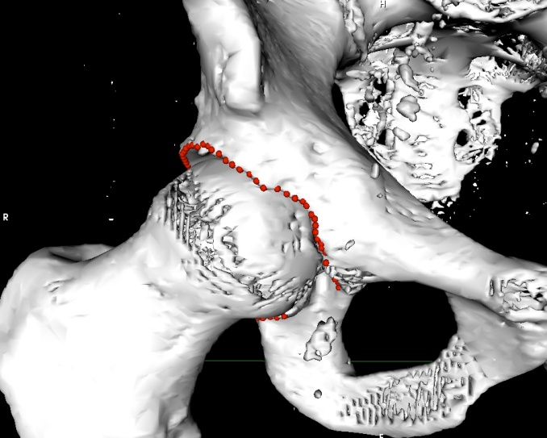
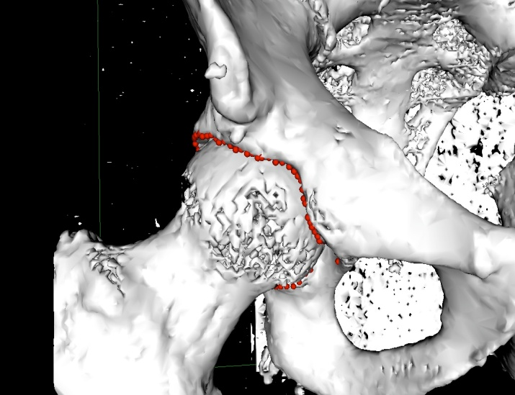
Conclusions: 200 Hips
E.Vandenbusche)
Curved (>2mm) (79%)
3 types of psoas valley
22% Risk - types
Angular V shape(11%)
Irrégular(11%)
Notes:
Les résultats ont montré que la projection polaire du rebord acétabulaire ressemble à une sinusoïde asymétrique constituée de successions de 3 sommets et de 3 dépressions. La courbe part à gauche de la corne postérieure pour aller à droite vers la corne antérieure.

Slide 15
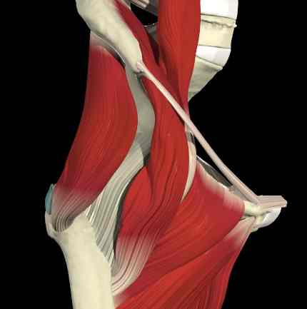
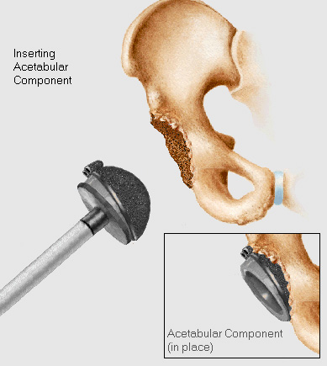
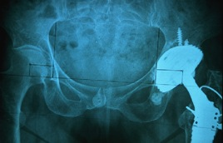
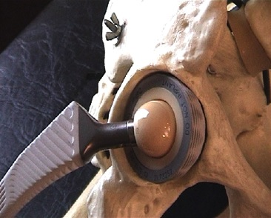
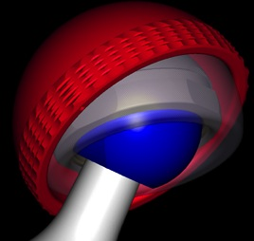
Psoas impingement
Can occur with all sort of cups
More often with cups:
- oversized
- few anteversed,
- with acetabulum insufficiently reamed
- Overflowing by cylindro-sphéric design
Notes:
Or ce conflit peut survenir avec tous types d’implant, même s’il est plus fréquent en cas de cupule
- surdimensionnée,
- peu antéversée (car elle déborde en avant),
- extruse par fraisage insuffisant,
- ou dont le dessin de l’implant cylindro-sphérique est débordant

Slide 16
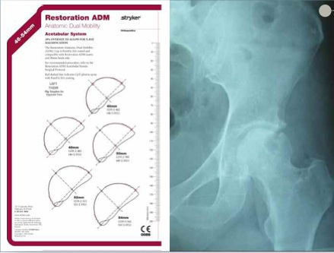
Pré-operative planning
Notes:
Pre-operative planning and X-ray evaluation aids in the selection of the most favorable implant style and optimal size for the patient’s hip pathology. Selecting potential implant styles and sizes can facilitate operating room preparation and assure availability of an appropriate size selection.
> X-ray evaluation may also help detect anatomic anomalies that could prevent the intra-operative achievement of the established pre-operative goals as Retore a good offset with femoral stem
.

Slide 17
APPROACH
Surgeon’s preferered approach
Instruments allows minimally invasive approach
Good view of acetabulum anterior rim
Notes:
The basic point is that the approach allow a good view of the acetabulum anterior rim vlew

Slide 18
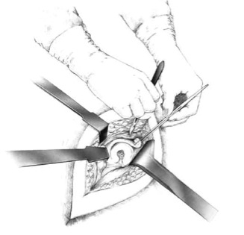
Acetabular préparation
Excision of the labrum and osteophytes
Remove soft tissues in the acetabulum
Proper vizualisation of bone
Identification of bony defects (graft)
Notes:
Bony Défects can be identified for a possible Grafting

Slide 19
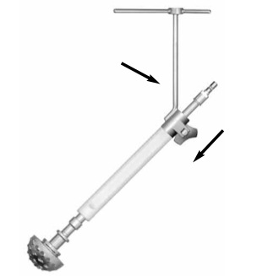
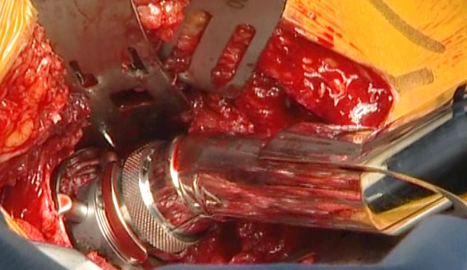
Reaming
Spherical reaming
Only « Cutting Edge » reamers
40-45° abduction
Caution acetabulum anteversion (respect anatomy)
1.5mm of interference fit is not always necessary: over-reaming of 1mm (more than 80%)
0.5 Interference fit is enough
Straight or angled reamers are available
Notes:
Caution acetabulum anteversion, Who can change according to the patients

Slide 20
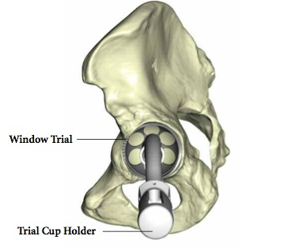
Trial
ADM Window Trial cup has an exact fit into the acetabulum (size for size)
Final implant has a press-fit of 1.5mm.
Window will help determine if shell is fully seated during impaction.

Slide 21
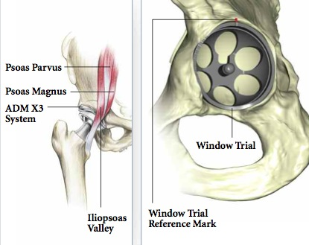
Trial
Grooved anterior notch = ilio-psoas valley
Make a mark on the acetabulum at the level of the superior reference mark
The ADM implant should be positioned so that the superior mark on the cup is aligned with the mark on the acetabulum.
Notes:
Mark with the diathermy knife

Slide 22
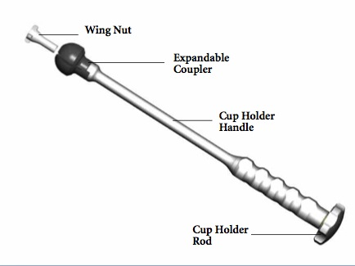
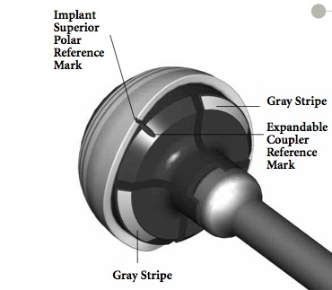
ADM Cup Implantation
Turn the rod to secure all components together
Do not expand the coupler too much prematurely
Expandable Coupler Reference mark = superior reference mark on the implant.
The grey stripes on the Expandable Coupler indicate the position of the cup notch (right or left) for the iliopsoas tendon
Notes:
The Expandable Coupler has a reference mark that corresponds to the superior reference mark on the implant. The gray stripes engraved on either side of the reference mark on the Expandable Coupler indicate the position of the cup notch (right or left) for the iliopsoas tendon

Slide 23
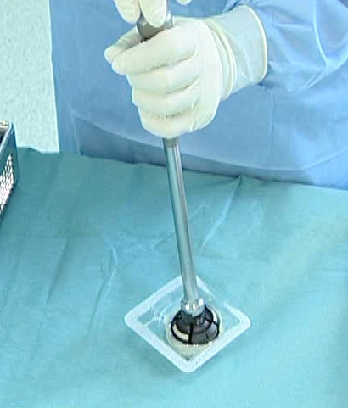
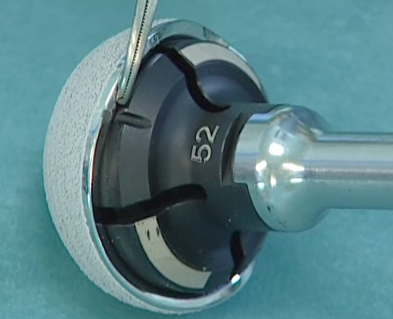
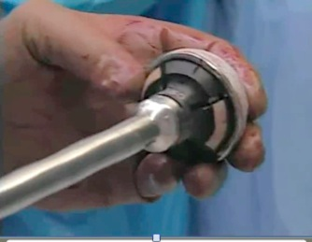
ADM Cup Implantation
Strongly tighten the Expandable Coupler onto the cup for a secure fit
Do not touch the HA coating
Notes:
The Expandable Coupler must be fully seated within the implant before tightening. Fully seating the Expandable Coupler can be achieved by pressing it vertically into the cup, while placed on a table. When fully seated, begin tightening the Expandable Coupler onto the cup for a secure fit. Following these instructions will help reduce the risk of the cup and Expandable Coupler/Cup Holder from disengaging during impaction.

Slide 24
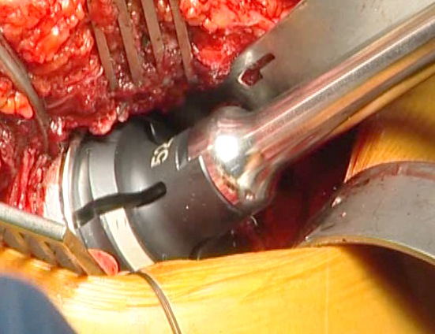
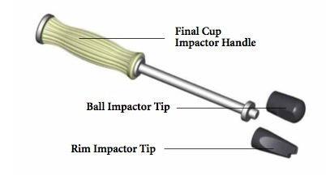
Cup Placement
Locate previous reference mark on the acetabulum
Good positioning: the top reference mark of the implant fits with this mark on the acetabulum.
Once securely impacted, turn the rod counter clockwise, then gently knock at the top of the rod and remove easily the cup holder.
A ball / rim impactor is available in final option or for reorientation
Notes:
Locate the reference mark made previously on the acetabulum. Position the cup according to the preset reference mark. Positioning the cup according to the preset reference mark
will ensure proper anatomic cup placement. Impact the cup into the acetabulum (Figure 11). Once the cup is securely impacted, remove the cup holder from the cup by turning the cup holder rod counter- clockwise and pulling the cup holder backwards with minimal force.

Slide 25
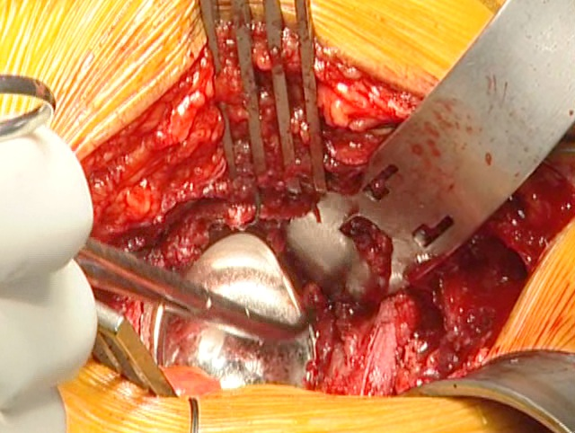
Check final position and fitting

Slide 26
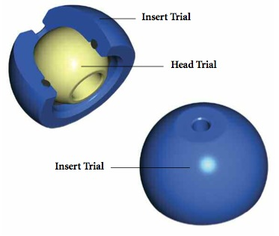
Trial Reduction
Place the insert – head trial unit onto the stem trunnion component and reduce the hip,
Check hip stability
Check restoration of leg length
The insert must move easily in the cup

Slide 27
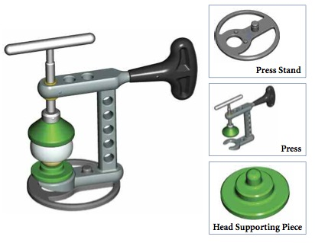
Insert - Head Implantation
Tighten the Press until the head is fully lodged into the insert.
After insertion, the air confined between the head and insert is usually released, resulting in a characteristic noise.
After the head and insert are assembled, verify that the coupling has complete mobility.

Slide 28
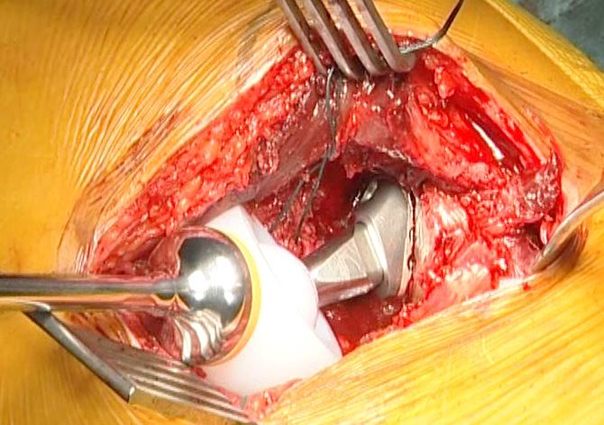
Reduction and Closure
Check that the inside of the shell is clean and free of soft tissue
Use the reduction tool
Avoid capsule impigment ( tract the sutures or clamp placed previously )
Check stability and R.O.M.
Dual mobility has good stability
Avoid tight closure of capsule and muscles
Notes:
Check that the inside of the shell is clean and free of soft tissue or other debris, which could prevent the insert from properly seating in the shell.

Slide 29
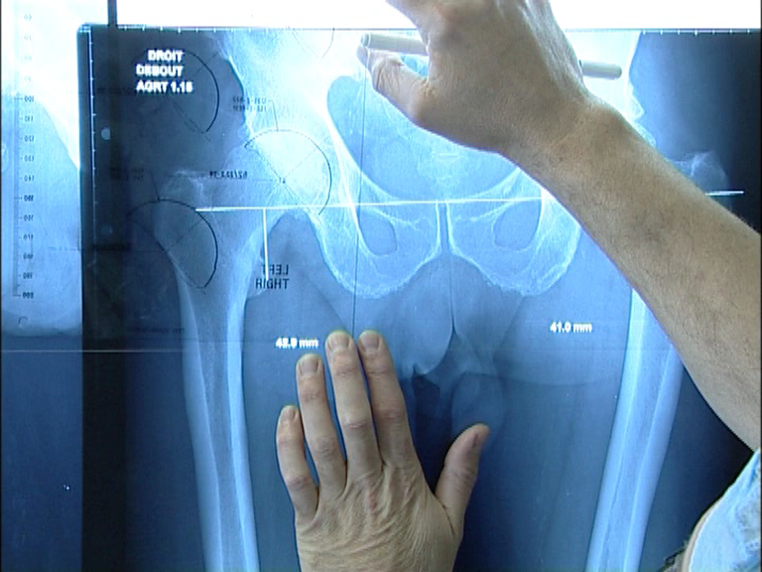

Slide 30


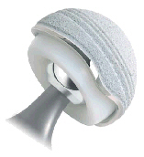
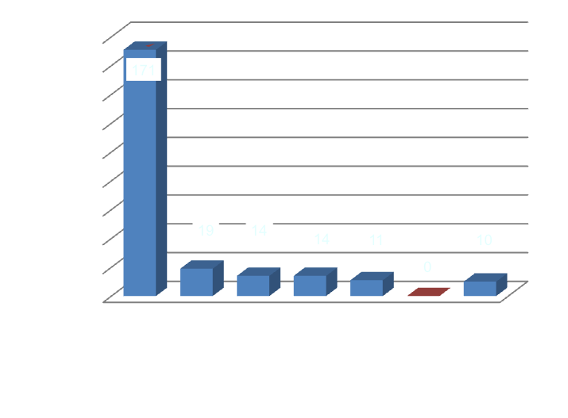
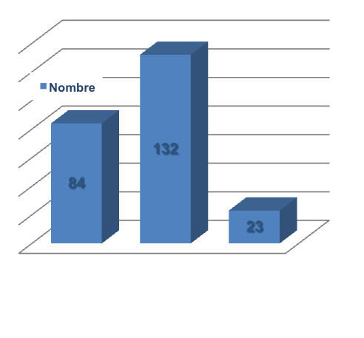
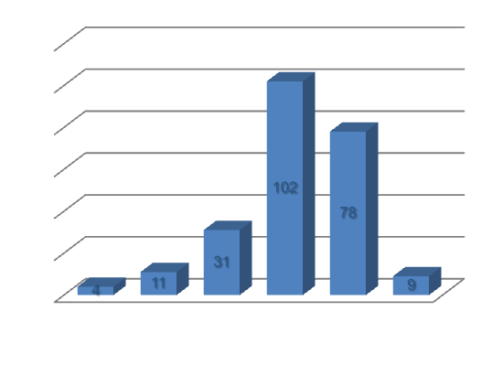
First results
ADM
N: 239
Age moyen: 75,88 ans
(42 -96)
Etiologie | N: 239
Arthrose | 71,55%
Nécrose | 7,95%
Rhumatismale | 0,42%
Post traumatique | 4,6%
Révision | 5,86%
CDH | 0,42%
Fracture fraîche | 0,42%

Slide 31
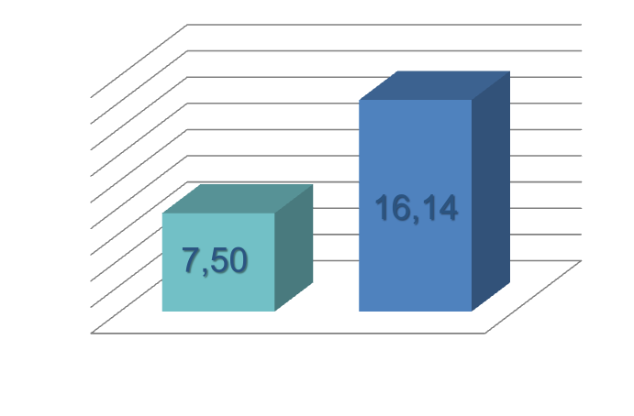
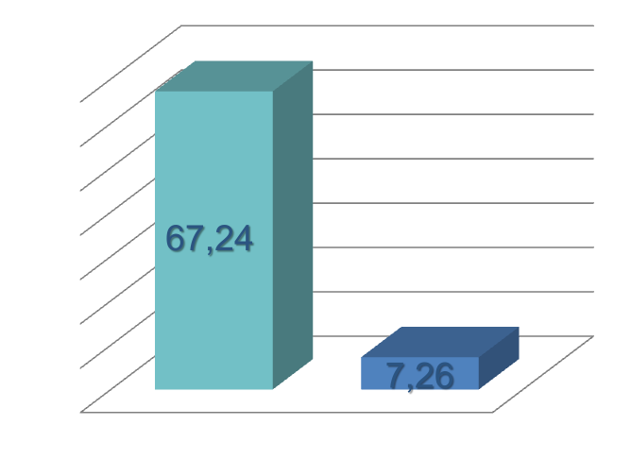
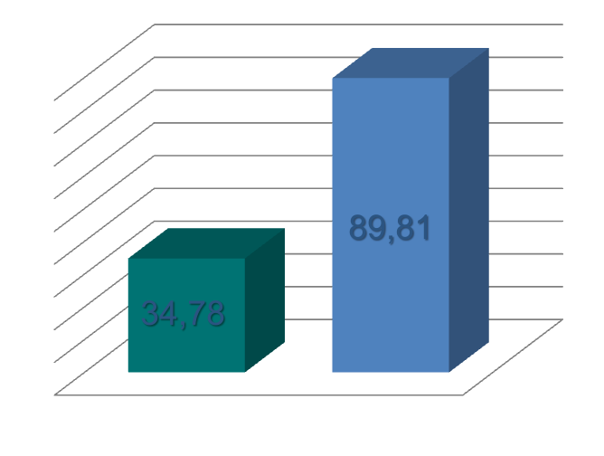
ADM
Firsts results
HHS moyen
PMA moyen
0 – 100 pts
0 – 18 pts
Womac moyen
96 – 0 pts

Slide 32
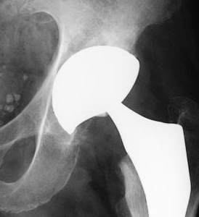
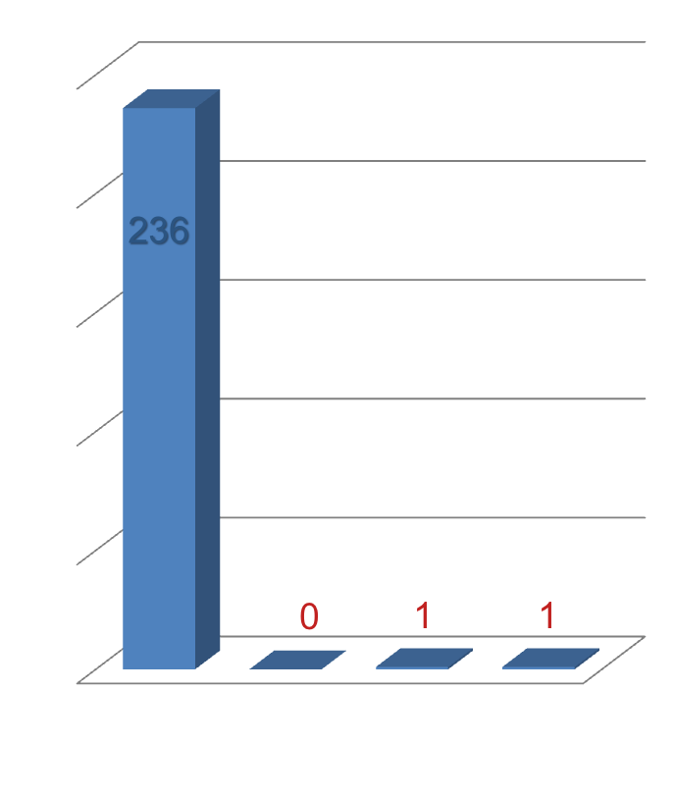
ADM
First results
236 survival(99,16%)
0 lost of follow up
1 deceased
1 failure (0,42%) :
Revision for acetabular protrusion on extreme porotic bone, in Parkinson patient
Dislocation = 0
Per-op Complications= 0
Cup Ostéo-intégration = 100%
Ilio-psoas impigment = 0

Slide 33
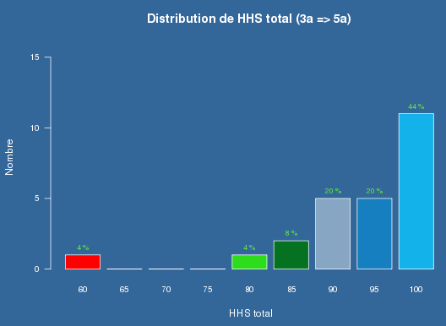

3 y.
HHS Womac

Slide 34




ADM
First impressions
F 81 ans
2 ans
F 79 ans
2 ans

Slide 35

Thank you for your attention

